Slide 1
Dengue Fever
Centre for Health Protection, Department of Health
July 2023

Slide 2
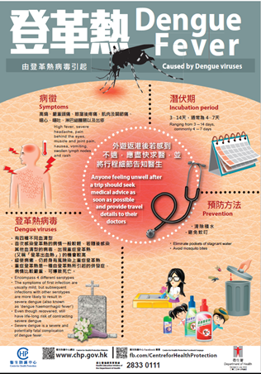
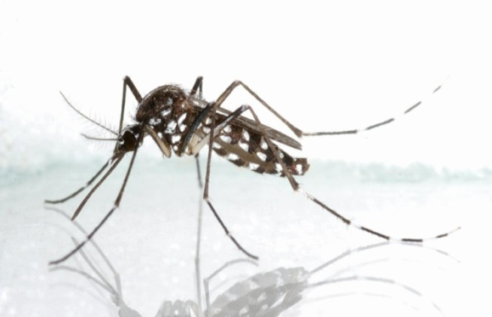
Dengue Fever
Causative agent
  Dengue viruses
  Encompass 4 different serotypes
  Each can lead to dengue fever and severe dengue (also known as 'dengue haemorrhagic fever')
Vectors
  Aedes aegypti
  Aedes albopictus
Source of photo:
Food and Environmental Health Department

Slide 3
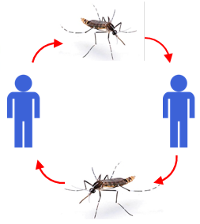
Mode of Transmission
Transmitted to humans through the bites of infective female Aedes mosquitoes
When a patient suffering from dengue fever is bitten by a vector mosquito, the mosquito is infected and it may spread the disease by biting other people
Cannot be spread directly from human to human (but there is evidence of low possibility of maternal transmission from a pregnant mother to her baby.)
In Hong Kong, dengue fever is mainly spread by Aedes albopictus
Aedes aegypti has not been found in recent years in Hong Kong.

Slide 4






Clinical Features
Incubation period ranges from 3 – 14 days, commonly 4 – 7 days
High fever
Severe headache
Rash
Swollen
lymph node
Muscle and
joint pain
Nausea and
vomiting
Pain behind the eyes

Slide 5
Clinical Features
Some infected people may not have obvious symptoms
Some may only have mild symptoms like fever
  like fever and rash

Slide 6
Clinical Features
  Symptoms of first infection
    usually mild
    Once recovered, lifelong immunity to that serotype of dengue virus will develop
    However, cross-immunity to the other three serotypes after recovery is only partial and temporary.
  Subsequent infections with other serotypes of dengue virus are more likely to result in severe dengue

Slide 7

Severe Dengue
A complication of dengue fever
Severe and potentially fatal
Initially, there are non-specific symptoms of dengue fever
  high fever, which lasts for 2 – 7 days and can be as high as 40 – 41°C
When the fever begins to subside (usually 2 – 7 days after symptom onset), warning signs of severe dengue may start to develop,
  which include severe abdominal pain, persistent vomiting, rapid breathing, fatigue, restlessness and manifestations of bleeding tendency

Slide 8

Later, there may be bleeding tendency:
  such as skin bruises, nose or gum bleeding, and possibly internal bleeding or blood in vomit or stool
In severe cases:
  circulatory failure, shock and death

Slide 9




After Recovery
  Immunity is attained against that serotype from its subsequent infection
  No effective protection is conferred against subsequent infection by the other 3 serotypes
    Cross-immunity is only partial and temporary
    Subsequent infections with any of the other 3 serotypes are more likely to result in severe dengue

Slide 10

Management
There is no specific medication for dengue fever and severe dengue
Patients with dengue fever
Patients with severe dengue
  Mostly self-limiting
  Symptomatic treatment is given to relieve discomfort like fever and pain
  Need to be treated promptly with supportive management
  With appropriate and timely treatment, death rate is less than 1%

Slide 11
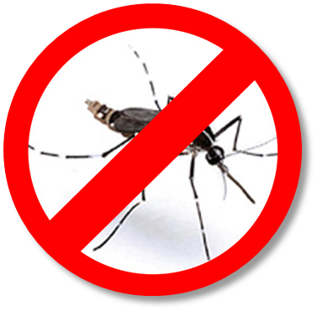
Preventive Measure
Prevent breeding of mosquitoes
Keep the environment clean
Remove stagnant water
Prevent mosquito bites

Slide 12
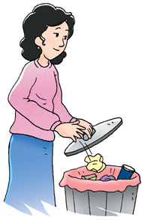
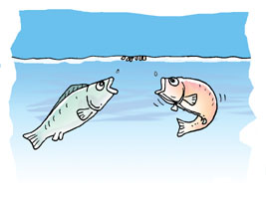
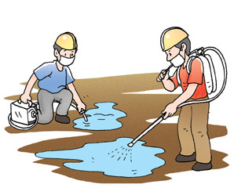
Prevent breeding of mosquitoes
Dispose of domestic wastes, empty bottles, cans and lunch boxes properly into a covered bin to prevent the accumulation of stagnant water
    In cultivation ponds, water tanks or large containers, biological controls such as keeping fishes to eat mosquito larvae would be a good option
    Remove stagnant water immediately if mosquitoes are found to be breeding
    Use environmentally friendly insecticides such as lavicidal oil if necessary

Slide 13
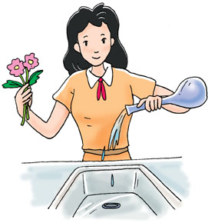


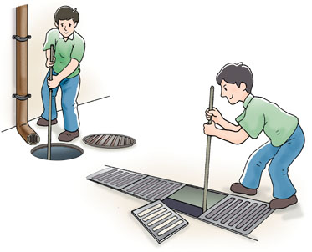
    Remove Stagnant Water
Remove or puncture any dumped tyres to prevent the accumulation of stagnant water
Avoid using saucers underneath flower pots
Put all used cans and bottles into covered dustbins
Change the water in vases at least once a week
Clean containers with stagnant water regularly (For examples, vases, water storage device of an air-conditioner, water tanks and pools)
Cover all water containers, wells and storage tanks tightly
Keep ditches free from blockage
Top up all defective ground surfaces

Slide 14
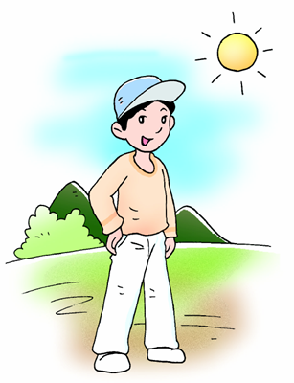
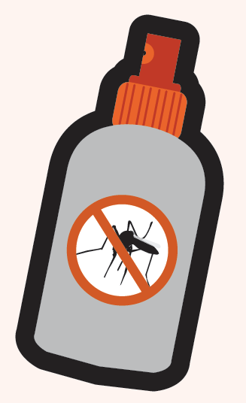
Prevent Mosquito Bites – Personal Protection
Wear loose, light-coloured, long-sleeved tops and trousers, and use DEET-containing insect repellent on exposed parts of the body and clothing; and re-apply according to instructions
Pregnant women and children of 6 months or older can use DEET-containing insect repellent (In general, use DEET of up to 30% for pregnant women and up to 10% for children)
Use mosquito screens or bed nets when the room is not air-conditioned
Place anti-mosquito devices near entrances such as windows and doors
Tips for using insect repellents: http://www.chp.gov.hk/en/view_content/38927.html

Slide 15
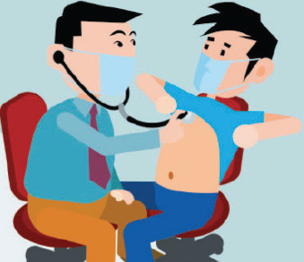
    Travel Tips
If going to affected areas or countries, arrange a consultation with doctor at least 6 weeks before the trip, have extra preventive measures to avoid mosquito bites.
For children who travel to countries or areas where mosquito-borne diseases are endemic or epidemic and where exposure is likely, children aged 2 months or above can use DEET-containing insect repellents with a concentration up to 30%

Slide 16
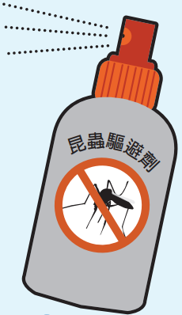
    Travel Tips
If travelling in endemic rural areas, carry a portable bed net and apply permethrin (an insecticide) on it. Permethrin should NOT be applied to the skin.
Scientific studies have shown that infected persons can transmit the virus to mosquitoes through mosquito bites even if they remain asymptomatic or before their onset of symptoms, leading to further spread of the disease. Hence, travellers who return from affected areas should apply insect repellent for 14 days after arrival to prevent mosquito bites. If People with dengue fever symptoms, should seek medical advice promptly

Slide 17
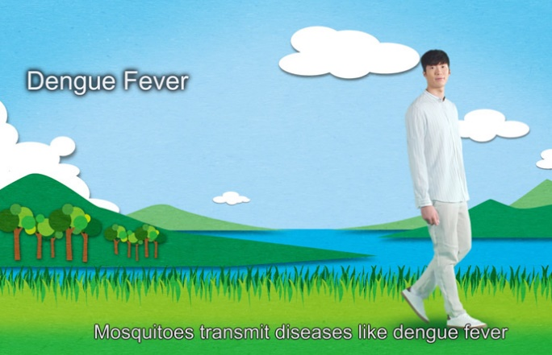

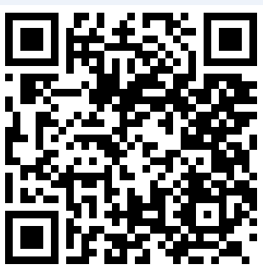
TV APIs
Prevention of mosquito-borne diseases
Prevention of dengue fever (subsequent infections)
https://m.youtube.com/watch?v=ulmBLMUuqyU
https://m.youtube.com/watch?v=x-sulfl0_e4

Slide 18

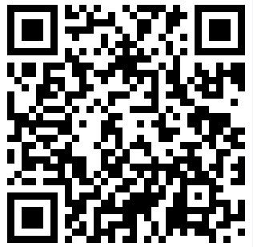

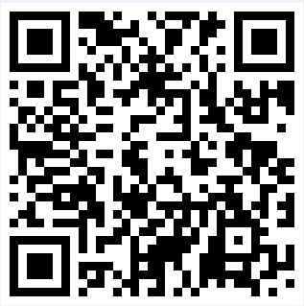

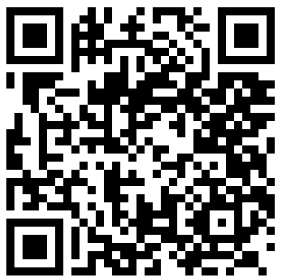

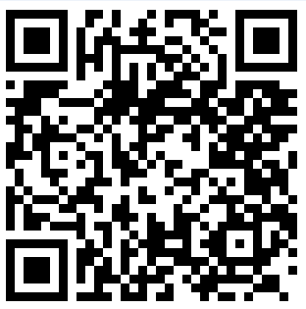


Videos
Video 3
Video 1
Video 4
Video 2
Video 5

Slide 19
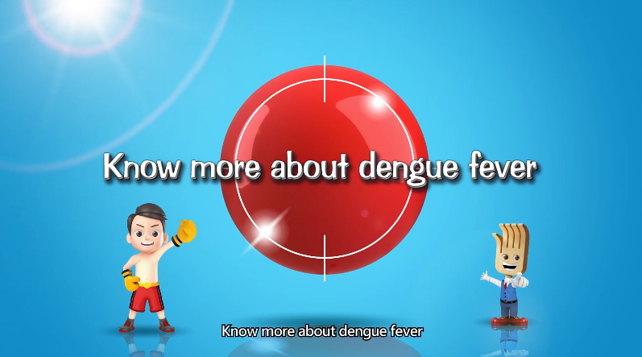
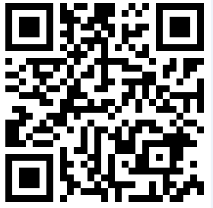
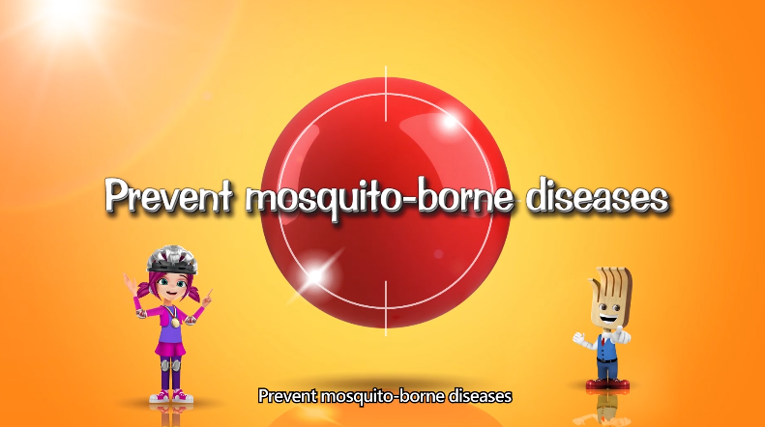

Videos
https://m.youtube.com/watch?v=KOxsfQpn90w&feature=youtu.be
https://m.youtube.com/watch?v=cZCpujZY5gQ&feature=youtu.be

Slide 20
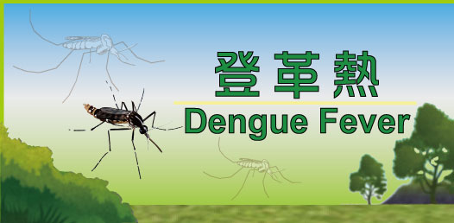


Health Education Resource
Centre for Health Protection Dengue Fever Thematic Website https://www.chp.gov.hk/en/features/38847.html
Travel Health Service Website
  www.travelhealth.gov.hk
Centre for Health Protection Facebook fanpage
Centre for Health Protection YouTube channel
Health Education Infoline of the Department of Health
☎ 2833 0111

Slide 21
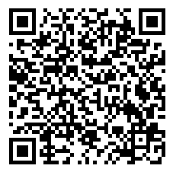
  Thank you!
Dengue Fever
Thematic Website
21

