Slide 1
Exercise Prescription Certificate Course
Session 1: Understanding Basic Concepts on Exercise and Handling Exercise Risks
Prof. Josephine IP Wing-yuk MBBS(HK), MS(HK), FRCOS (HK)

Slide 2
Outline of this Session
About this Certificate Course
Basic concepts of exercise physiology
Basic components of a single exercise session
Pre-participation health screening
Self-guided Screening
Professionally Guided Screening
Exercise-related musculoskeletal injury
Overseas Guidelines / Recommendations on Exercise
Banned substances for athletes

Slide 3
About this Certificate Course

Slide 4
About this Certificate Course
Objectives:
Empowers participating doctors with knowledge and technique of prescribing exercise to patients
Hope that growing numbers of citizens will be engaged in increasing and regular physical activities.
Format: 4 lectures + 1 optional practicum session
“Certificate of attendance” will be issued to registrants with > 75% attendance among 4 lectures; while “certificate of achievement” will be issued to those who attended the practicum as well.

Slide 5
About this Certificate Course
Evaluation Study (Self-administered questionnaire)
Aim:
To examine the impact of the series of the EPP training on the participating doctors’ KAP on PA promotion; and
To collect suggestions from the participating doctors on possible room for improvement of the EPP training.
Study consists of 3 phases:
First day, 1-2 months and 6 months after completion of lectures

Slide 6
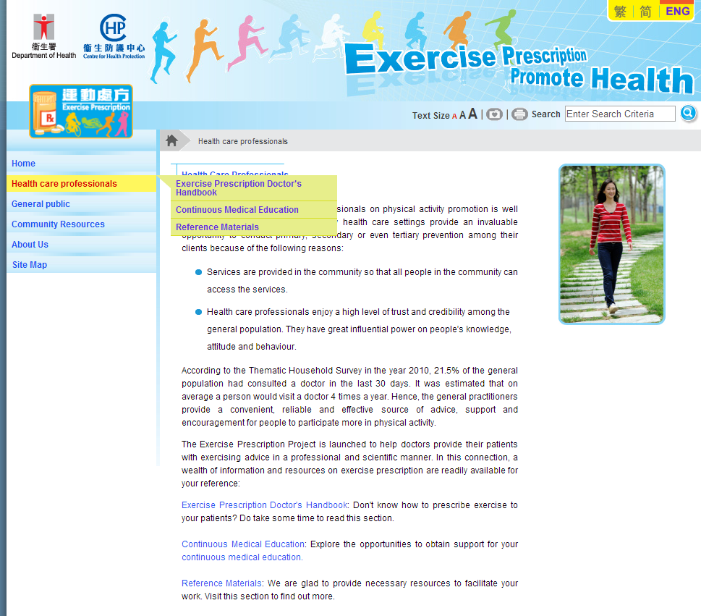
About this Certificate Course
You can find all you need at EPP’s thematic website http://exerciserx.cheu.gov.hk

Slide 7
Basic Concepts of Exercise Physiology

Slide 8
Basic Terminology…
Physical Activity 「體能活動」
Any bodily movement produced by the contraction of skeletal muscle that increases energy expenditure above a basal level. In this course, physical activity generally refers to the subset of physical activity that enhances health

Slide 9
Basic Terminology…
Exercise 「運動」
A subcategory of physical activity that is planned, structured, repetitive, and purposive in the sense that the improvement or maintenance of one or more components of physical fitness is the objective.
Used interchangeably with “exercise training” and generally refer to physical activity performed with the primary purpose of improving or maintaining physical fitness, physical performance, or health

Slide 10
Basic Terminology…
Sport 「體育運動」
Sport covers a range of physical activities performed within a set of rules and undertaken as part of leisure or competition. Sporting activities usually involve physical activity carried out by teams or individuals and are supported by an institutional framework, such as a sporting agency

Slide 11
Basic Terminology…
Exercise Dose / Dosage
Refers to the amount of physical activity performed by the subject/ participant. The total dose or amount is determined by the three components of activity:
Frequency - commonly expressed in sessions, episodes, or bouts per day or per week
Duration - the length of time for each bout of any specific activity
Intensity - the rate of energy expenditure necessary to perform the activity to accomplish the desired function (aerobic activity) or the magnitude of the force exerted (resistance exercise)

Slide 12
Basic Terminology…
Progression of Exercise
Refers to the process of increasing the intensity, duration, frequency, or amount of activity or exercise as the body adapts to a given activity pattern.

Slide 13
Various Types of Physical Activity
Types of Physical Activity | Advantages
Aerobic Activity | Improves body composition and cardiorespiratory fitness
Muscle-strengthening Activity | Improves muscular fitness such as muscular strength and endurance
Stretching Activity | Improves flexibility such as range of motion
Neuromuscular Activity | Improves neuromuscular fitness such as balance, agility and proprioception

Slide 14
Basic Components of a Single Exercise Session

Slide 15
What Constitute an Exercise Session?
Warm-up: At least 5-10 mins of low to moderate intensity aerobic exercise or resistance exercise with lighter weights.
Conditioning: 0-60 mins of aerobic, resistance, neuromuscular, and/or sport activities
Cool-down: At least 5-10 mins of low to moderate intensity aerobic exercise or resistance exercise with lighter weights
Stretching: At least 10 mins performed after the warm-up or cool-down phase

Slide 16
Pre-participation Health Screening

Slide 17
Have You Faced this Dilemma Before?
A patient with certain cardiovascular risk factors presented to you.
You know regular exercise could help to alleviate the patient’s cardiovascular risk factors in long term, BUT…
You also know exercise may induce cardiac events during participation
Then, should exercise be advised to this patient?

Slide 18

Therefore, before prescribing any exercise,
a pre-participation health screening AND
a risk stratification process should be carried out to identify
high risk individuals!

Slide 19
Pre-participation Health Screening
The identification of risk factors for adverse exercise-related events can be achieved through a two-tier approach consisting of:
a Self-guided Screening and/or
a Professionally Guided Screening

Slide 20
Self-guided Screening
Self-administered tools can be used by anyone who is planning to start an exercise programme, e.g.:
Physical Activity Readiness Questionnaire (PAR-Q)
7 questions (1 page), for people aged 15-69
AHA/ACSM Health/Fitness Facility Pre-participation Screening Questionnaire
Slightly more complex than PAR-Q
Uses history, symptoms, and risk factors (including age) for screening

Slide 21
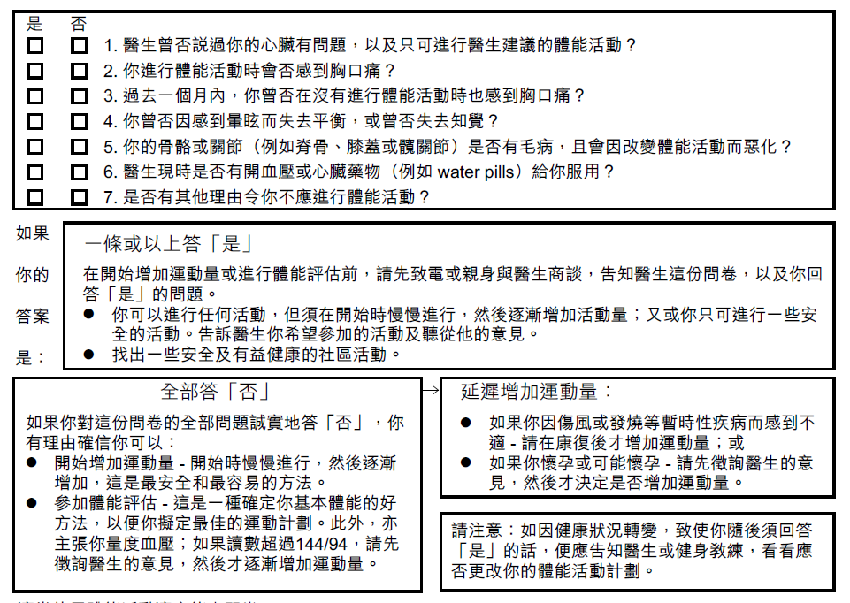
PAR-Q

Slide 22
Self-guided Screening
Negative Screens:
Could start becoming much more physically active without consulting medical professionals
Positive Screens:
Should consult medical professionals before starting to become more physically active

Slide 23
Professionally Guided Screening/ Evaluation
Medical History
Physical Examination
+/- Investigation, if indicated

Slide 24
Professionally Guided Screening/ Evaluation
Clinical Protocols/ Tools:
ACSM Risk Stratification Scheme
PARmed-X, PARmed-X for Pregnancy
Cardiovascular evaluation of middle-aged/senior individuals engaged in leisure-time sport activities by EACPR
Quantitative estimate of 10-year risk of coronary events e.g. Framingham Risk Score, SCORE
Guidelines for Cardiac Rehabilitation and Secondary Prevention Programs by AACPR

Slide 25
Professionally Guided Screening/ Evaluation
PARMed-X

Slide 26
PARMed-X
To be used by a physician with patients who have had positive responses to PAR-Q. It contains:
A checklist of medical conditions for which a degree of precaution and/or special advice should be considered
Three categories of precautions (viz. Absolute Contraindications; Relative Contraindications AND Special Prescriptive Conditions)
Physical Activity Readiness Conveyance/Referral Form - an optional tear-off tab for the physician to convey clearance for physical activity participation, or to make a referral to a medically-supervised exercise program
(http://exerciserx.cheu.gov.hk/files/PARmed-X.pdf)

Slide 27
Absolute Contraindication
Permanent restriction or temporary restriction until the condition is treated, stable, and/or past acute phase.

Slide 28
Condition of Absolute C/I
Cardiovascular condition
Dissecting aortic aneurysm
Severe aortic stenosis
Congestive heart failure
Crescendo angina
Acute myocardial infraction
Acute/recent myocarditis
Acute pulmonary/systemic embolism
Thrombophlebitis
Ventricular tachycardia and other dangerous arrhythmias ( e.g. multi-focal ventricular activity)
Infections
Acute infectious disease (regardless of etiology)

Slide 29
Relative contraindication
Highly variable. Value of exercise testing and/or program may exceed risk. Activity may be restricted.
Desirable to maximize control of condition.
Direct/indirect medical supervision of exercise program may be desirable.

Slide 30
Condition of relative C/I
Cardiovascular
Moderate aortic stenosis
Severe subaortic stenosis
Marked cardiac enlargement
Uncontrolled/high rate supraventricular dysrhythmias
Repetitive/frequent ventricular ectopic activity
Ventricular aneurysm
Untreated/uncontrolled pulmonary/systemic hypertension
Hypertrophic cardiomyopathy
Compensated congestive heart failure
Infections
Subacute/chronic/recurrent infectious diseases (e.g. malaria, others)

Slide 31
Condition of relative C/I
Metabolic
Uncontrolled metabolic disorders (e.g. diabetes, thyrotoxicosis, myxedema)
Pregnancy
Complicated pregnancy (e.g. toxaemia, haemorrhage, incompetent cervix)

Slide 32
Professionally Guided Screening/ Evaluation
ACSM Risk Stratification Scheme

Slide 33
ACSM Risk Stratification Scheme
Assigns participants into one of its three risk categories according to specific clinical criteria
Appropriate recommendations before exercise initiation or progression could be made regarding the necessity for further medical workups and diagnostic exercise testing.

Slide 34
CVD, Pulmonary Diseases and Metabolic Diseases Suggesting High Risk for PA
Cardiovascular Disease | Cardiac diseases Cerebrovascular disease Peripheral vascular disease
Pulmonary Diseases | Chronic obstructive pulmonary disease Asthma Interstitial lung disease
Metabolic Diseases | Diabetes mellitus Significant thyroid disorder Significant renal disease Significant liver disease

Slide 35
Clinical Features Suggesting High Risk for Physical Activity
Pain, discomfort in the chest, neck, jaw, arms
SOB at rest or with mild exertion
Dizziness or syncope
Orthopnea or paroxysmal nocturnal dyspnea
Ankle edema
Palpitations or tachycardia
Intermittent claudication
Known heart murmur
Unusual fatigue with usual activities

Slide 36
Cardiovascular Disease Risk Factors (RFs) for Use with the ACSM Risk Stratification (I)
Positive CVD RFs | Defining Criteria
Age | M ≥ 45 yo OR F ≥ 55 yo
Family history | Ml /coronary revascularisation OR < 55 yo Sudden death in father/other male 1º relative OR < 65 yo Sudden death in mother/ other F 1º relative
Cigarette smoking | Current smoker OR Ex-smoker < 6 m OR Exposure to ETS
Sedentary lifestyle | Without ≥ 30 mins of moderate intensity PA on ≥ 3 d/wk for 3m
Obesity | BMI ≥ 25kg/m2 OR Waist Size ≥ 90cm (in M) / ≥ 80cm (in F)
Hypertension | SBP ≥ 140 mmHg OR DBP ≥ 90 mmHg (at 2 occasions) OR On antihypertensive medication

Slide 37
Cardiovascular Disease Risk Factors (RFs) for Use with the ACSM Risk Stratification (II)
Positive CVD RFs | Defining Criteria
Dyslipidaemia | Total cholesterol ≥ 5.2 mmol/L OR HDL cholesterol < 1 mmol/L OR LDL cholesterol ≥ 3.4 mmol/L OR On lipid-lowering medication
Pre-diabetes | IFG (i.e. FBG 5.6 - 6.9 mmol/L) OR Impaired glucose tolerance (i.e. 2-hour post-prandial BG is 7.8-11 mmol/L)
Negative CVD RFs | Defining Criteria
High HDL | HDL cholesterol > 1.6 mmol/L
If HDL is high, subtract one risk factor from the sum of positive risk factors

Slide 38
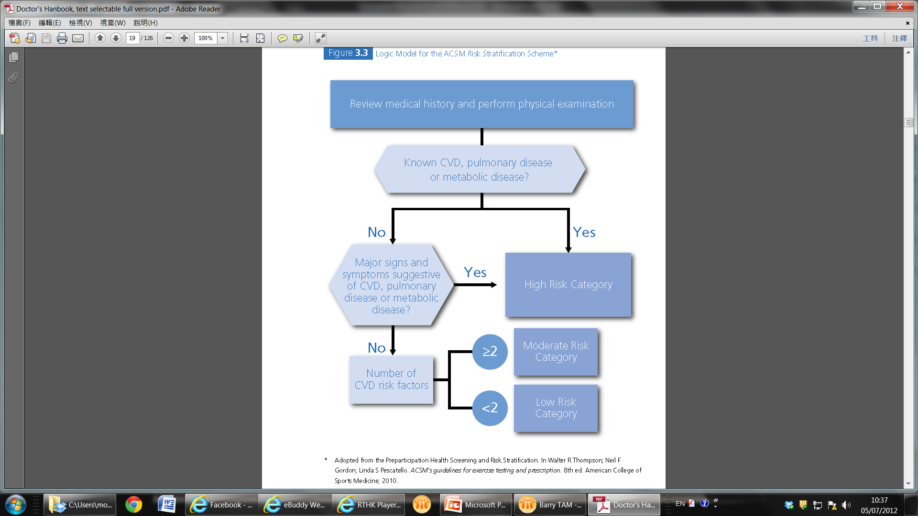
Logic Model for the ACSM Risk Stratification Scheme
2
1
3

Slide 39
ACSM Recommendations on Exercise Testing based on the ACSM Risk Stratification
Risk Category | Whether further medical workup and exercise testing indicated?
 | For low-moderate intensity PA | For vigorous intensity PA
Low | NOT necessary | NOT necessary
Moderate | NOT necessary | Further medical workup RECOMMENDED NOT necessary to do ex. testing
High | Both RECOMMENDED | Both RECOMMENDED
For stable hypertensive patients with presence of TOD, medical clearance and exercise testing are also recommended before moderate intensity PA
For diabetic patients with <10% risk of coronary event over a 10-year period, exercise testing may NOT be necessary before engaging in low to moderate intensity PA

Slide 40
Availability of Exercise Testing, Supervision or Monitoring in HK
Common interests for some health care specialties:
Cardiology
Respiratory Medicine
Physiotherapy
Sports Medicine
A/V in Both Public and Private Sectors

Slide 41
Exercise-related Musculoskeletal Injury

Slide 42
Know the benefits of PA…
Strong Evidence
Lower risk of premature death
Lower risk of CHD, stroke
Lower risk of type 2 diabetes & High BP
Lower risk of adverse blood lipid & metabolic syndrome
Lower risk of colon & breast cancer
Weight loss & Prevention of weight gain
Prevention of falls
Reduced depression
Better cognitive function
Moderate to strong Evidence
Better functional health (for older adults)
Reduced abdominal obesity
Moderate Evidence
Reduced symptoms of depression
Lower risk of hip fracture
Lower risk of lung cancer
Lower risk of endometrial cancer
Weight maintenance after weight loss
Increased bone density
Improved sleep quality

Slide 43
Exercise-related Musculoskeletal Injury
Overall, the benefits of being physically active outweigh the potential harms
Both physical fitness and total amount of exercise affect risk of musculoskeletal injuries
The dose-injury relationship for specific activities is unknown and likely differs by activity and individual anatomic and behavioural characteristics

Slide 44
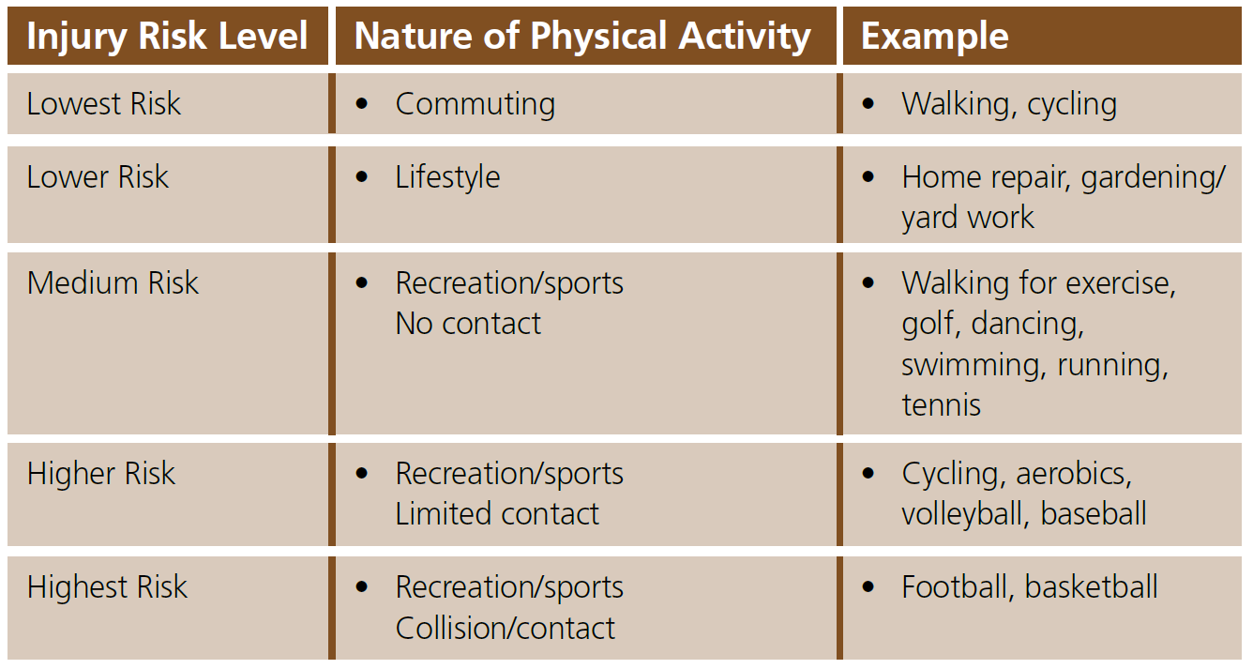
Continuum of Injury Risk

Slide 45
Reminders for Safe Physical Activity
Do types of physical activity that are appropriate for current fitness level and health goals.
Increase physical activity gradually over time. Inactive people should “start low and go slow”.
Putting on protective gear, looking for safe environments, following rules and instructions, and making sensible choices about when, where, and how to be active.
People with chronic conditions and symptoms should consult family doctor about the types and amounts of activity suited to their needs.

Slide 46
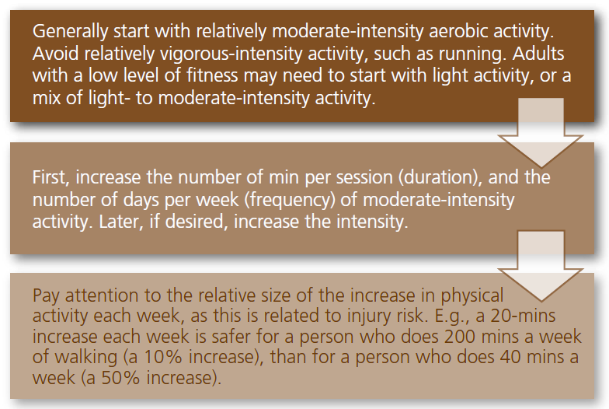
General Guidance on How to Increase Physical Activity

Slide 47
Overseas Guidelines/ Recommendations on Exercise

Slide 48
Guidelines/ Recommendations on Exercise
WHO. Global recommendations on physical activity for health 2010
UK DH. UK Physical Activity Guidelines 2011
ACSM. ACSM's guidelines for exercise testing and prescription 2010
US DHHS. Physical Activity Guidelines Advisory Committee Report, 2008

Slide 49
Banned substances for Those who take part in sports (Athletes)

Slide 50
World Anti-doping Agency (WADA)
WADA established in 1999 as an international independent agency composed and funded equally by the sport movement and governments of the world.
World Anti-doping Code
The document harmonizing anti-doping policies in all sports and all countries.
works in conjunction with 5 International Standards aimed at bringing harmonization among anti-doping organizations in various technical areas
Testing;
Laboratories;
Therapeutic Use Exemptions (TUEs);
The List of Prohibited Substances and Methods;
The protection of privacy and personal information.

Slide 51
The Prohibited List of Substances
As mandated by World Anti-Doping Code, WADA has published an annual List of Prohibited Substances and Methods since 2004
Most updated version: 2014

Slide 52
Prohibited List
Class S0 – S5
Substance that prohibited at ALL time (i.e. in competition and out of competition)
Class S6 – S9
Substance that prohibited IN competition
Class P1 – P2
Substance that prohibited in particular sports

Slide 53
Substance that prohibited at ALL time
S0 – NON APPROVED SUBSTANCES (e.g. non-registered drugs)
S1 - ANABOLIC AGENTS (e.g. Anabolic Androgenic Steroids (AAS), Clenbuterol)
S2 - PEPTIDE HORMONES , GROWTH FACTORS AND RELATED SUBSTANCES
S3 - BETA 2 AGONISTS
S4 - HORMONE AND METABOLIC MODULATORS
S5 - DIURETICS AND OTHER MASKING AGENTS

Slide 54
Substance that prohibited IN competition
S6 - STIMULANTS
S7 - NARCOTICS
S8 - CANNABINOIDS
S9 - GLUCOCORTICOSTEROIDS

Slide 55
Substance that prohibited in particular sports
P1 – Alcohol (ethanol) | P2 – Beta blocker
Prohibited IN competition ONLY in Air Sports• Archery Automobile Karate Motorcycling Powerboating | Prohibited IN competition ONLY in • Automobile Billiards • Darts Golf• Skiing/Snowboarding in ski jumping, freestyle aerials/halfpipe and snowboard halfpipe/big air Prohibited IN competition & Out of Competition Archery Shooting

Slide 56
So, …
How do I know whether it is a banned substances once my client asked?

Slide 57
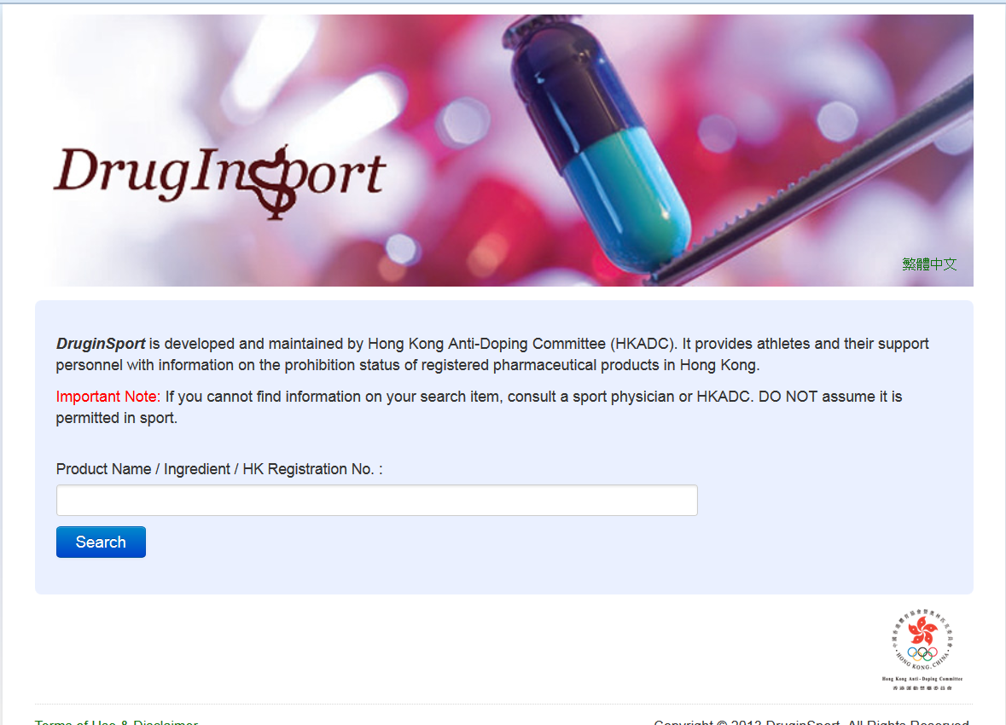
The easiest way
Search the online database DrugInSport

Slide 58
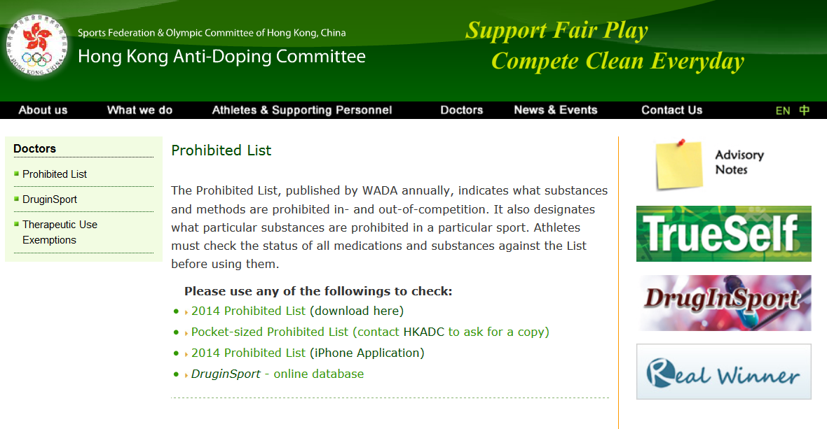
The other way
Visit Hong Kong Anti-doping Committee and download the prohibited list

Slide 59
Oh…
I find that my prescription is one of the banned substances in the list but my client need this to treat his illness, what and how can I do?

Slide 60
Treatment under exemptions (TUE)
Applied by the athletes (your client)
The athletes are required to obtain a valid TUE before the start of using of any prohibited substance
Doctor needs to offer help to fill in the required information in TUE form for your clients

Slide 61
End of Presentation
Please refer to Doctor’s Handbook: Chapters 1, 2, 3, 4 and 13 for further reading

Slide 62
Questions and Answers

