Slide 1
Exercise Prescription Certificate Course
Session 3: Practical Tips for Constructing a Progressive Stretching and Resistance Training Programme

Slide 2
Outline of this Session
Principles of prescribing flexibility training programme
Different types of stretching exercise
Principles of prescribing resistance exercise
Some Practical Examples of Resistance Exercise

Slide 3
Principles of Prescribing Flexibility Training

Slide 4
Benefits of Flexibility Training
Reduced muscle tension
Easier and smoother muscle contractions
Improved ease of movement
Decrease in soreness from exercise
May help prevent injury from sudden mishaps
Prevents muscle tendon from shortening

Slide 5
Types of Stretching
Static stretching
Ballistic stretching
Proprioceptive neuromuscular facilitation (PNF)

Slide 6
Static stretching
Active or passive
slow stretching to the point of discomfort
hold for 10-30 seconds
minimal risk of injury
shown to be effective

Slide 7
Ballistic stretching
repetitive bouncing movements
residual muscle soreness and acute injury
discouraged for non-athlete

Slide 8
Proprioceptive neuromuscular facilitation (PNF)
alternate contraction and relaxation
residual muscle soreness
time-consuming
partner required
potential for injury if too vigorous

Slide 9
Benefits
Functional:
Improve flexibility
Encourage neuromuscular relaxation
Prevent sports and overuse injuries
Facilitate rehabilitation of injured tissues

Slide 10
Benefits
Physiological:
Increase muscular blood flow
Facilitate recovery from fatigue
Reduce delay-onset muscle soreness
Suppress pain perception of muscle

Slide 11
Principles of constructing flexibility training programme for exercise beginner
Avoid ballistic and jerky movements
Prior to, during and after the major workouts
avoid some sports-specific stretching techniques
from large joints(large muscle grops) to small joints (small muscle groups)
pinpoint to the joints (muscle groups) of poor flexibility
Warm-up the joints before stretching

Slide 12
Frequency:
2 to 3 d/wk with daily being most effective
Intensity:
Stretch to the point of feeling tightness or slightly discomfort

Slide 13
Time:
Hold a static stretch for 15 – 30 seconds (adults)
Hold a static stretch for 30-60 seconds (older adults)
For PNF, 3-6 s of light-to-moderate contraction followed by a 10-30 s assisted stretch
Types:
Each of the major muscle-tendon units is recommended

Slide 14
Volume:
Perform 60 s of total stretching time for each flexibility exercise
Pattern:
2-4 stretches for each exercise
Flexibility exercise is the most effective when the muscle is warmed

Slide 15
Different Types of Stretching Exercise

Slide 16
Muscle groups
Trapezius muscles (Neck/Shoulder)
Deltoids (Shoulder)
Triceps (Posterior arm)
Pectorals (Chest)
Adductors (Inner Thigh)
Quadriceps (Anterior Thigh)
Hamstrings (Posterior Thigh)
Calf (Posterior Leg)
Erectors (Lower Back)

Slide 17
Procedures
Stretch the joint gently and slowly until you feel mild stretching sensation
Sustain 5 to 10 seconds initially
Avoid forceful and ballistic stretching and bouncing actions
When the stretching sensation starts diminishing, add a little bit pressure
Sustains for 10 to 20 seconds continuously
Repeat the action 2 to 4 times and then do on the other side
Keep breathing throughout the movement

Slide 18
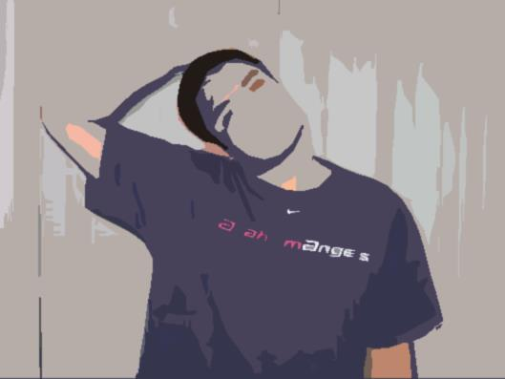
Trapezius muscles (Neck/Shoulder)

Slide 19
Relax the shoulder, side-flex your head to the right
Place your right hand at the left side of forehead, add pressure until mild stretching sensation at left shoulder, and then hold 5 seconds
When the stretching sensation ‘diminishes’, add pressure in the same direction
Hold the stretch for 10-20 seconds

Slide 20
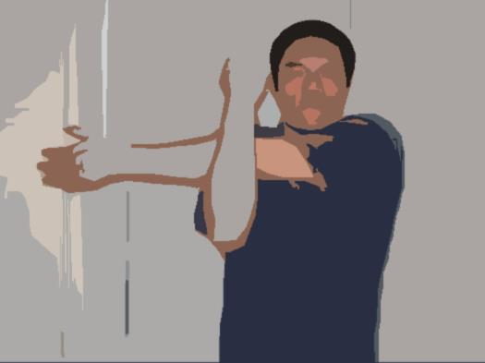
Deltoids (Shoulder)

Slide 21
Left arm cross the chest horizontally
Use right forearm to press left arm to the chest at elbow position until mild stretching sensation at left shoulder, and then hold 5 seconds
When the stretching sensation ‘diminishes’, add pressure in the same direction
Hold the stretch for 10-20 seconds

Slide 22
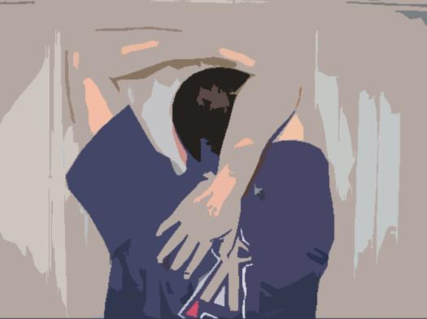
Triceps (Posterior arm)

Slide 23
Place right hand behind neck
Use left hand to pull right elbow to the occipital process until mild stretching sensation at right arm, and then hold 5 seconds
When the stretching sensation ‘diminishes’, add pressure in the same direction
Hold the stretch for 10-20 seconds

Slide 24
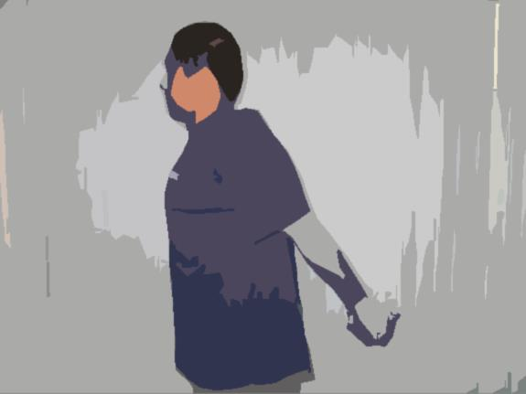
Pectorals (Chest)

Slide 25
Stand with legs at shoulder width
Hold the hands together behind back, raise the extended arms slowly until mild stretching sensation at arms and chest, and then hold 5 seconds
When the stretching sensation ‘diminishes’, add pressure in the same direction
Hold the stretch for 10-20 seconds

Slide 26
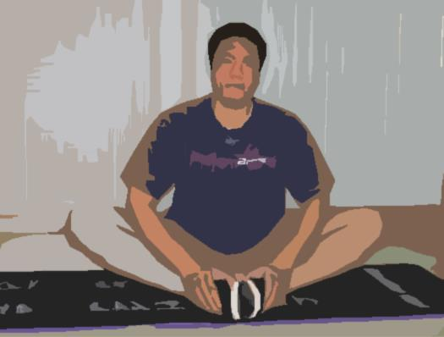
Adductors (Inner Thigh)

Slide 27
Sit on the floor with knee bent, keep feet together
Straighten the back
Use hands to push the knee downwards until mild stretching sensation at inner thigh, and then hold 5 seconds
When the stretching sensation ‘diminishes’, add pressure in the same direction
Hold the stretch for 10-20 seconds

Slide 28
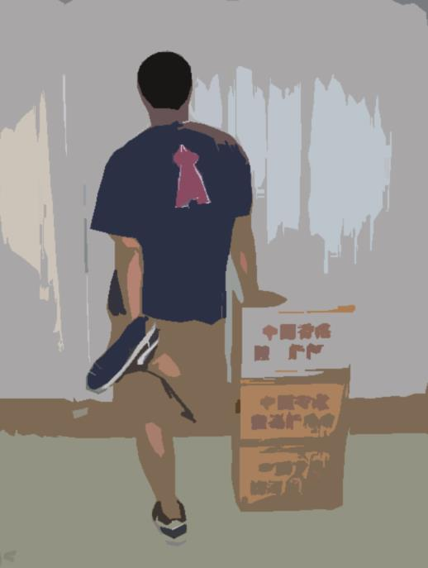
Quadriceps (Anterior Thigh)

Slide 29
Right hand support at the wall, use left hand to pull right feet to buttock until mild stretching sensation at anterior thigh, and then hold 5 seconds
Keep the body straight
When the stretching sensation ‘diminishes’, add pressure in the same direction
Hold the stretch for 10-20 seconds

Slide 30
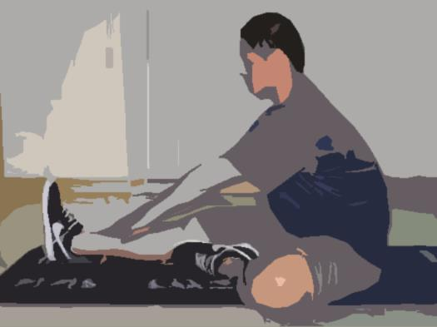
Hamstrings (Posterior Thigh)

Slide 31
Sit on the floor with extended knee
Bend the left knee and place at the floor with inward sole
Keep the back straight, flex the trunk towards right feet with extended arms until mild stretching sensation at posterior thigh, and then hold 5 seconds
When the stretching sensation ‘diminishes’, add pressure in the same direction
Hold the stretch for 10-20 seconds

Slide 32
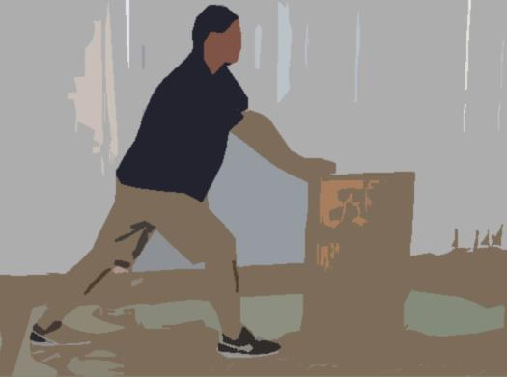
Calf (Posterior Leg)

Slide 33
Stand with wide step, right leg forward, left leg at the back, Toes forwards,
Hands support at the wall, bent the front leg, straighten the back leg, keep the sole on ground until mild stretching sensation at lower leg, and then hold 5 seconds
When the stretching sensation ‘diminishes’, add pressure in the same direction
Hold the stretch for 10-20 seconds

Slide 34
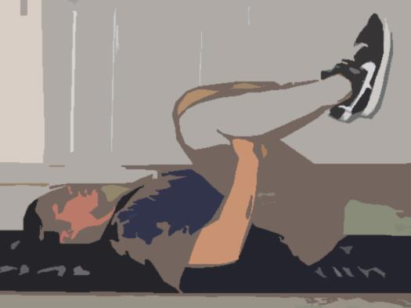
Erectors (Lower Back)

Slide 35
Hold the thigh at the chest in supine lying position
Add pressure at the posterior thigh until mild stretching sensation at lower back, and then hold 5 seconds
When the stretching sensation ‘diminishes’, add pressure in the same direction
Hold the stretch for 10-20 seconds
Keep the neck and shoulder relaxed

Slide 36
Principles of Prescribing Resistance Exercise

Slide 37
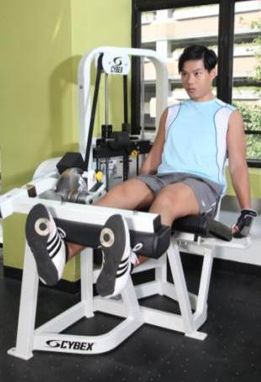
Definition of Resistance Exercise
Exercise that increases skeletal muscle strength, power, endurance, and mass
Include strength training, resistance training, or muscular strength and endurance exercises

Slide 38
FIVE Essential Components of Prescribing Resistance Exercise
FITT
Frequency
Intensity (i.e. Load/ Weight)
Time (i.e. Volume: Sets & Reps)
Type
Progression
Dosage
of Exercise

Slide 39
The “Frequency” of Prescribed Resistance Exercise
FITT
The number of days per week dedicated to an exercise of EACH muscle group
All muscle groups may be trained in the same session (i.e. whole body) or each session may “split” the body into selected muscle groups so that only a few of them are trained in any one session
E.g. lower body muscles trained on Monday and Thursday while upper body muscles trained on Tuesday and Friday (i.e. each muscle group is trained on 2 days/ wk)

Slide 40
The “Intensity” of Prescribed Resistance Exercise
FITT
Refers to the amount of weight or resistance assigned to a set of resistance exercise for each muscle group
Expressed as % of a person’s one-Repetition Maximum for that particular exercise (i.e. %1-RM):
1-RM: the greatest resistance or weight that a particular muscle group can move through the full range of motion for a single repetition in a controlled manner with good posture

Slide 41
The “Time” of Prescribed Resistance Exercise
FITT
No specific amount of time is recommended for resistance exercise, while Repetitions (Reps) and Sets are standard ways to refer to the working “time” needed
A “Rep" is one performance of a single exercise for a particular muscle group
A “Set” comprises a group of reps performed without stopping

Slide 42
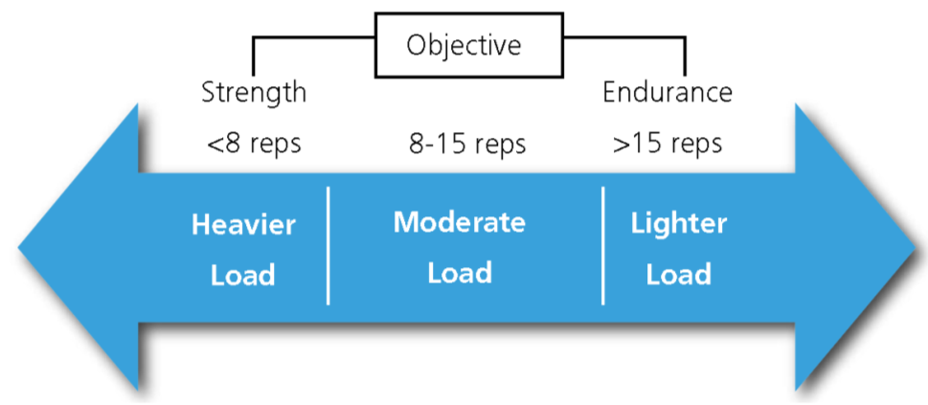
The “Time” of Prescribed Resistance Exercise
FITT
A reasonable rest interval btw sets is 2-3 min
The number of rep performed with each set and the load of exercise are inversely related
↑load, ↓no. of rep that needed

Slide 43
The “Type” of Prescribed Resistance Exercise
FITT
Resistance exercises count if they involve a moderate to high level of intensity and work the major muscle groups of the body:
legs, hips, back, chest, abdomen, shoulders, and arms, etc.
Best to include multi-joint/ compound exercises
usually take the form of free weights or weight machines, but also working with resistance bands and doing calisthenics (using body weights)
Individuals who are new to resistance exercises should receive instructions from trained personnel before engaging in these exercises

Slide 44
The “Progression” of Prescribed Resistance Exercise
Rate of Progression of Resistance Exercises
An initial increase in the number of rep is recommended before an increase in load
When the participant can comfortably achieve the “upper limit” of the prescribed repetition range, for example, 12 to 15 reps, training loads may be increased (e.g. by ̴5%)
So that no more than 12 reps are completed without volitional fatigue

Slide 45
FIVE Essential Components of Prescribing Resistance Exercise
FITT
Frequency
Intensity (i.e. Load/ Weight)
Time (i.e. Volume: Sets & Reps)
Type
Progression
Dosage
of Exercise

Slide 46
Prescribing Resistance Exercise to Healthy Adults

Slide 47
Recommendations for Prescribing Resistance Exercise to Healthy Adults
Frequency: Each muscle group on 2 to 3 day/wk with at least 48 hours separating the training sessions for the same muscle group
Intensity: A load of 60 to 80% 1-RM for each set of exercise

Slide 48
Recommendations for Prescribing Resistance Exercise to Healthy Adults
Time:
Each target muscle group should be trained for a total of 2 to 4 sets with 8 to 12 reps /set
Rest interval of 2-3 minutes in between
Type:
8 to 10 resistance exercises working major muscle groups of the body
Multi-joint exercises involving >1 muscle group and targeting both agonist and antagonist muscle groups are preferable

Slide 49
Prescribing Resistance Exercise to Healthy Older Adults

Slide 50
Recommendations for Prescribing Resistance Exercise to Healthy Older Adults
Frequency: Perform resistance exercise ≥ 2 nonconsecutive days/wk
Intensity: An intensity between moderate (5 to 6) and vigorous (7 to 8) on a 10-point scale

Slide 51
Recommendations for Prescribing Resistance Exercise to Healthy Older Adults
Time:
8-10 resistance exercises
Each target muscle group should be trained for a total of a total of >1 set with 10 to 15 reps/set
Subsequent to a period of adaptation and improved musculo-tendinous conditioning, older adults may also choose to follow guidelines for younger adults
Type:
E.g. Progressive weight training, weight bearing calistenics, stair climbing and other muscle strengthening activities that use major muscle groups

Slide 52
Some Practical Examples of Resistance Exercise

Slide 53
顏色 | 阻力
白 | 最弱
黃 | 弱
紅 | 中弱
綠 | 中
藍 | 中強
黑 | 強
銀 | 最強
金 | 超強

Slide 54
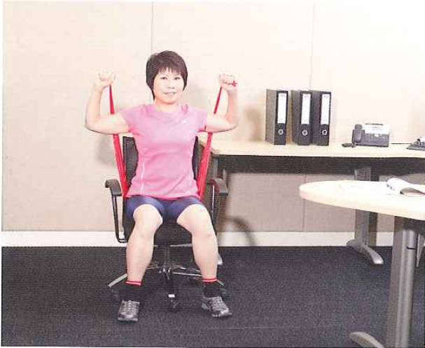
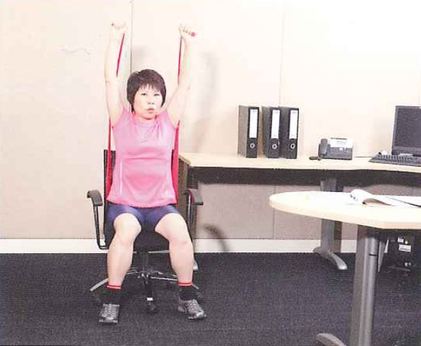
Shoulders- seated shoulder press

Slide 55
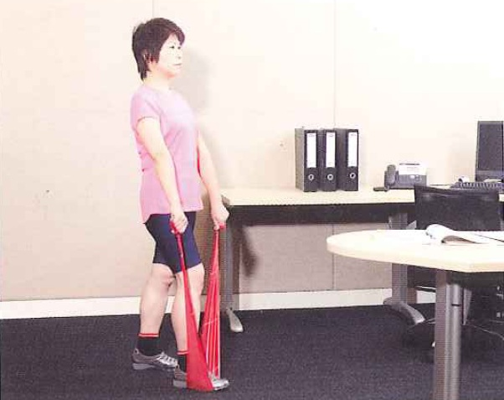
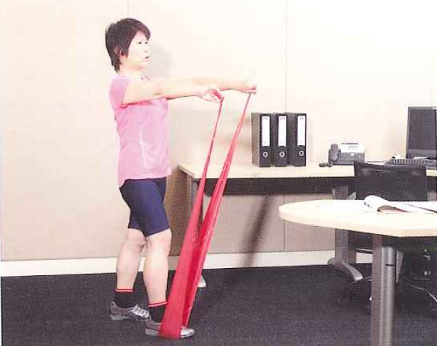
Shoulders- front raise

Slide 56
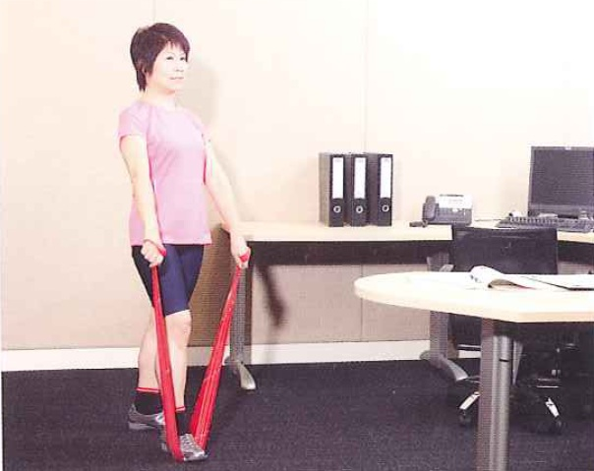
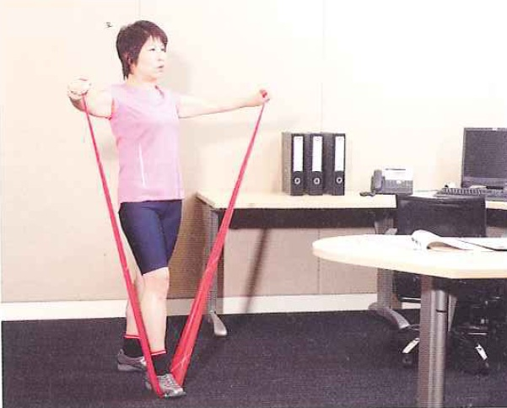
Shoulders-lateral raise

Slide 57
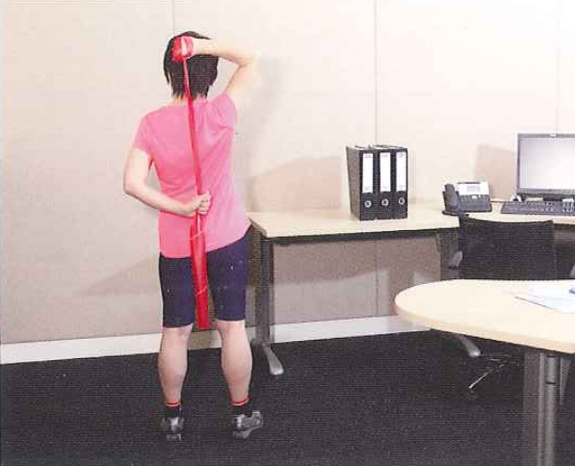
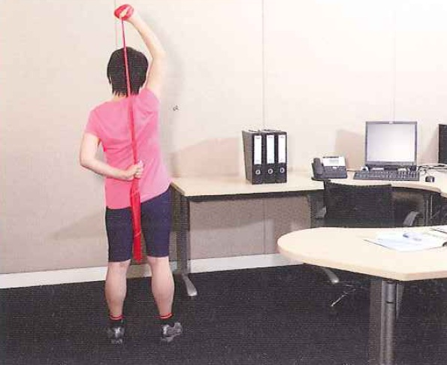
Arms- triceps overhead extension

Slide 58
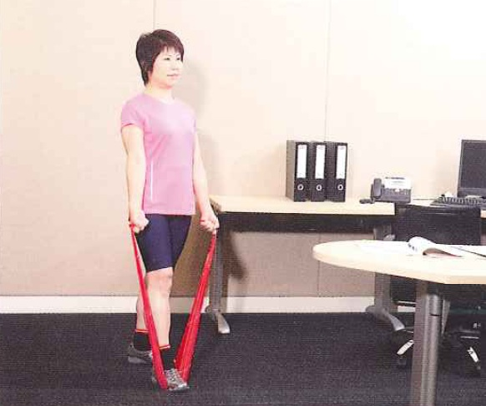
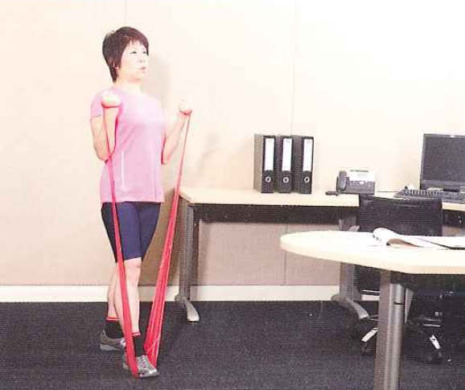
Arms-biceps curl

Slide 59
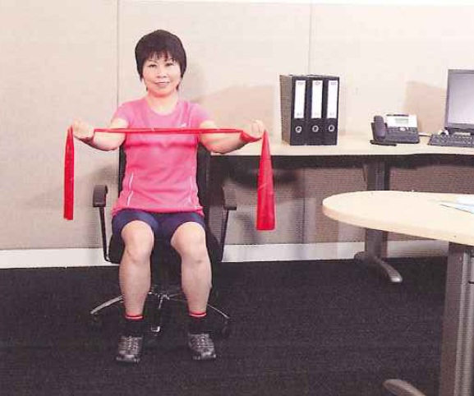
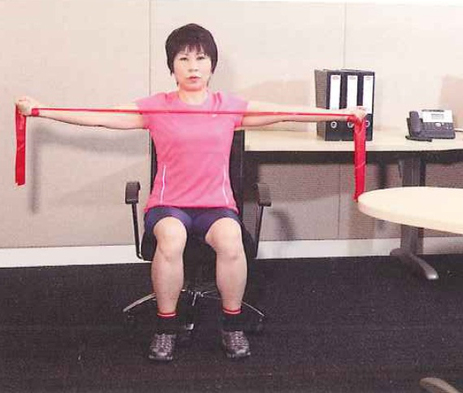
Back- reverse fly

Slide 60
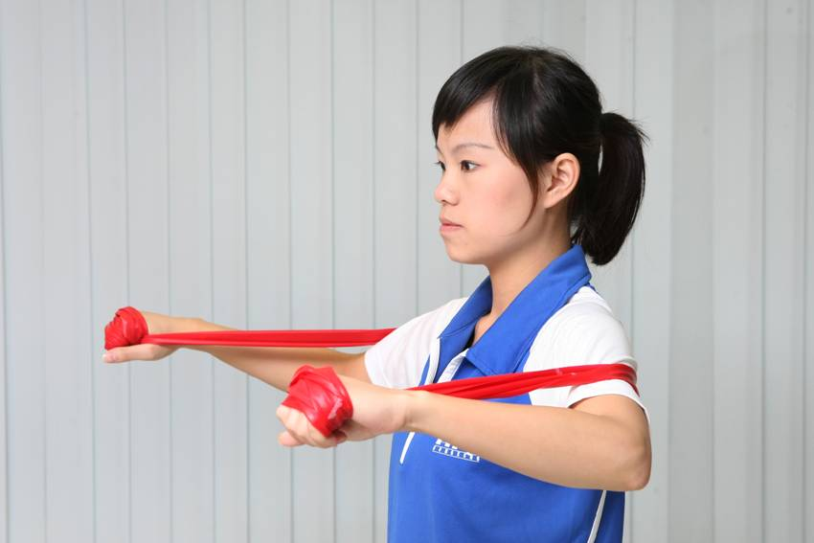
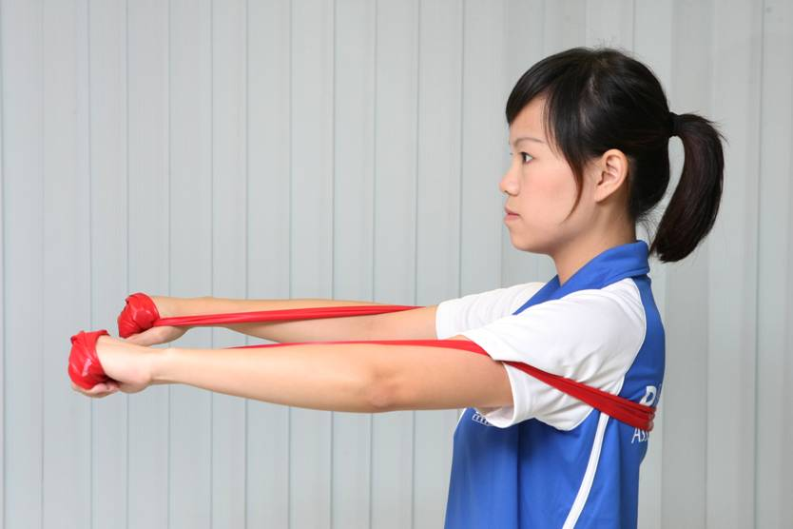
Chest- chest press

Slide 61
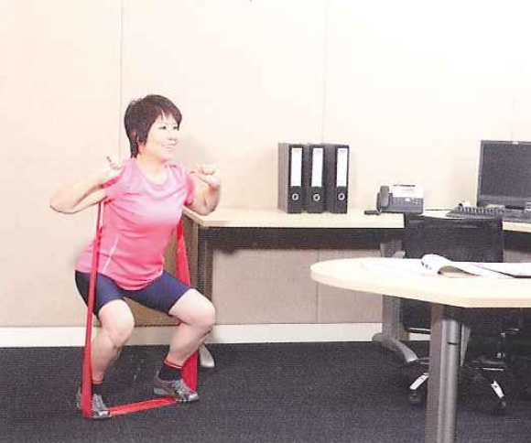
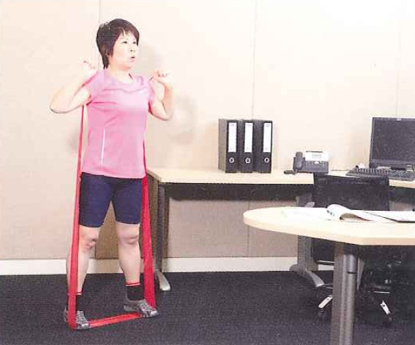
Hips and thighs- squat

Slide 62
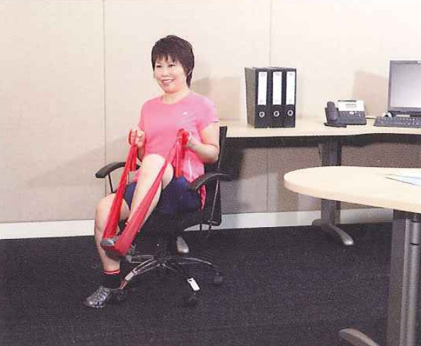
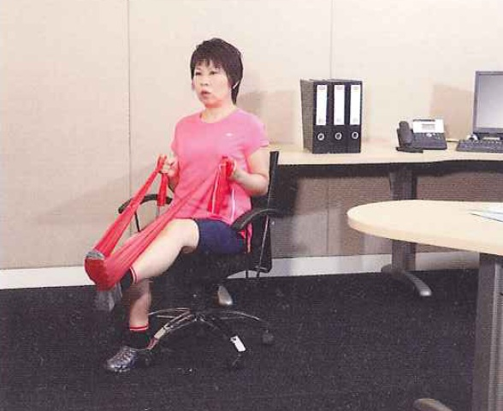
Hips and thighs- single leg press

Slide 63
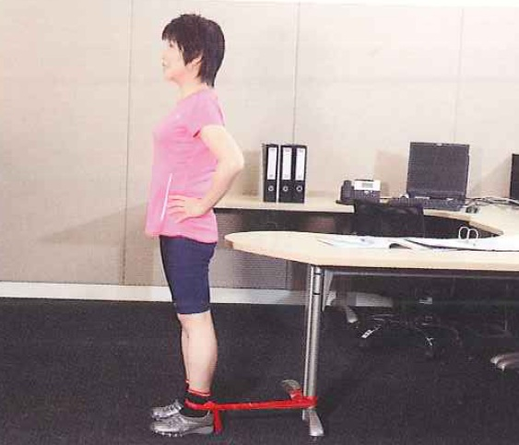
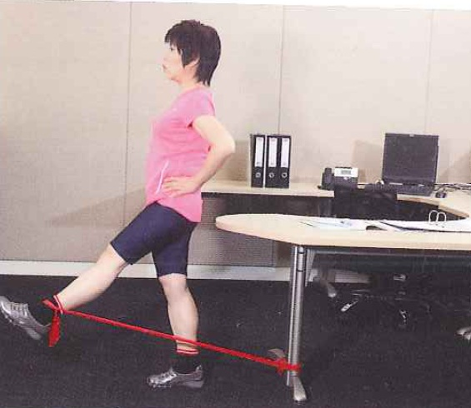
Hips and thighs- hip flexion

Slide 64
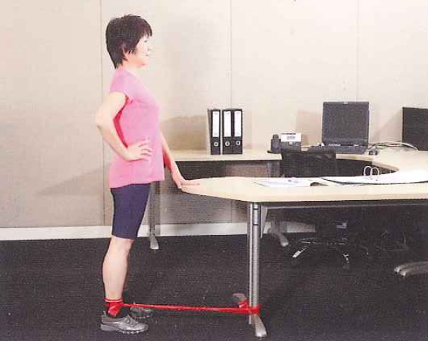
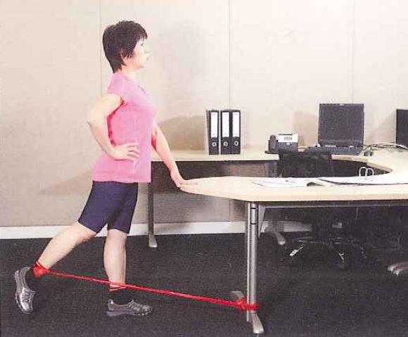
Hips and thighs- hip extension

Slide 65
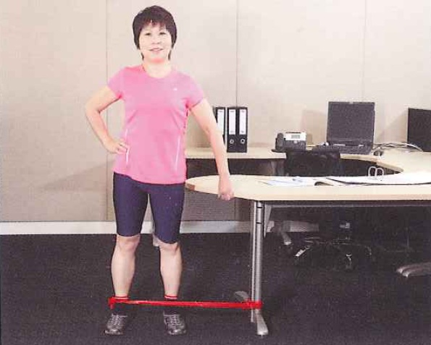
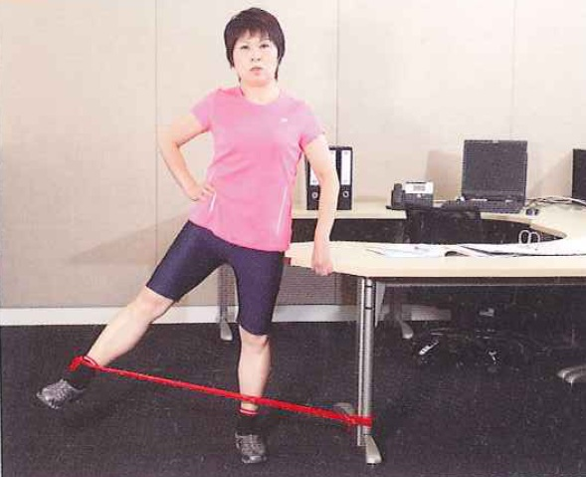
Hips and thighs- hip abduction

Slide 66
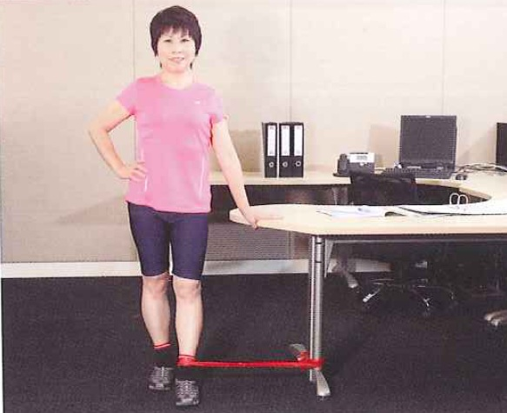
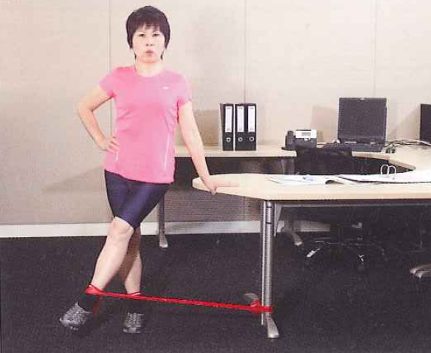
Hips and thighs- hip adduction

Slide 67
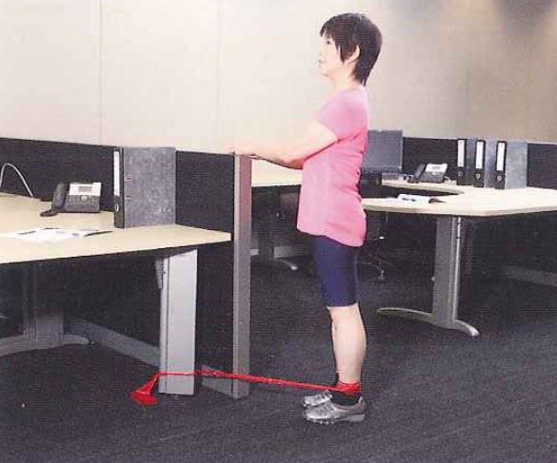
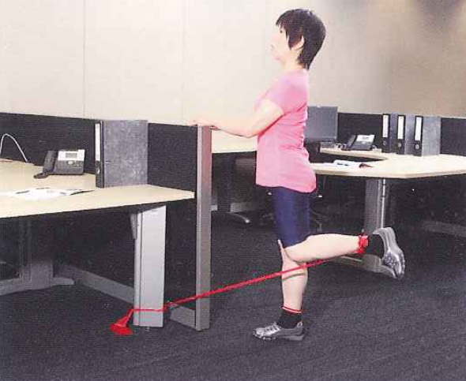
Hips and thighs- leg curl

Slide 68
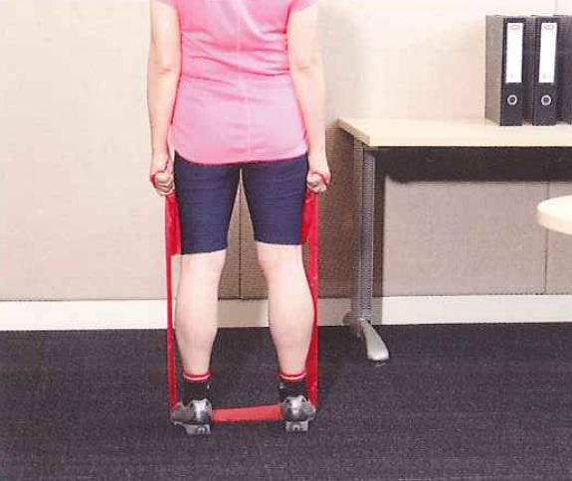
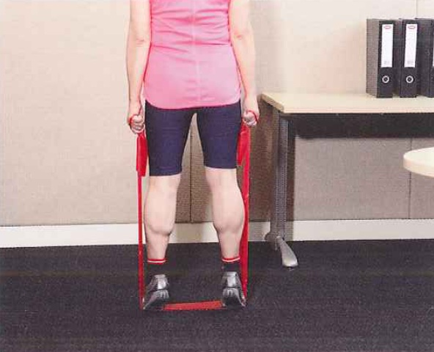
Calves- calf raise

Slide 69
End of Presentation
Please refer to Doctor’s Handbook: Chapters 5 for further reading

Slide 70
Questions and Answers

