Slide 1
Exercise Prescription Certificate Course (2014/15)
Session 4:
Exercise Recommendations for
Persons with Special Needs
&
Motivating Your Clients
Hong Kong Physiotherapy Association

Slide 2
Outline of this Session
Prescribing Exercise to Patients with Diabetes Mellitus, Hypertension, Heart Disease, Osteoarthritis, Osteoporosis
Motivating your clients: Improving Exercise Adoption and Maintenance
Prevention of Exercise Related Injuries
Exercise Practice
Clinical Case Study

Slide 3
Self-Study
Doctor’s Handbook: Chapters 4 – 11, 13 for further reading

Slide 4
Prescribing Exercise to Patients with Diabetes Mellitus

Slide 5
DM Patients’ Acute Response to Exercise
Blood glucose utilisation by muscles usually rises more than hepatic glucose production → blood glucose levels tend to decline → risk of exercise-induced hypoglycemia for those taking insulin and/or insulin secretagogues if medication dose or carbohydrate consumption not altered
* On the other hand, hypoglycemia rare in DM patients not treated with insulin or insulin secretagogues

Slide 6
Benefits of Exercise for DM Patients
Structured exercise interventions can lower A1C by 0.7% in people with T2 DM
Progressive resistance exercise improves insulin sensitivity in older men with Type 2 DM to the same or even greater extent as aerobic exercise

Slide 7
Evaluation of the DM Patient Before Recommending an Exercise Programme
Assess patients for contraindicating conditions, e.g.
uncontrolled hypertension
severe autonomic neuropathy
severe peripheral neuropathy
history of foot lesions
unstable proliferative retinopathy

Slide 8
Exercise stress testing
NOT routinely recommended to detect ischaemia in asymptomatic individuals at low coronary heart disease (CHD) risk (<10 % in 10 yrs)
Advised primarily for sedentary adults with DM who are at higher risk for CHD and who would like to undertake activities more intense than brisk walking
Some Risk Factors for CHD include:
Age > 40,
Concomitant risk factors such as hypertension, microalbuminuria, etc.,
Presence of advanced cardiovascular or microvascular complications (e.g. retinopathy, nephropathy)

Slide 9
Recommendations for Prescribing Exercise to DM Patients
Exercise prescription with the FITT principle
More or less the same as that recommended for Healthy Adults
Rate of progression should be gradual

Slide 10
Recommendations for Prescribing Aerobic Exercise to Patients with DM
Frequency: Perform moderate-intensity aerobic PA on ≥ 3 days/wk
Intensity: At least at moderate intensity. Additional benefits may be gained from vigorous-intensity aerobic exercise
Time: Perform 20-60min per day to a total of ≥ 150 min/wk
Type:
Exercise requires little skill to perform is preferable
Evidence showed that walking is an excellent choice

Slide 11
Recommendations for Prescribing Resistance Exercise to Patients with DM
Frequency: Perform ≥ 2 nonconsecutive days/wk, ideally 3 times/week
Intensity: An intensity between moderate and vigorous intensity (i.e. 50-80% of 1-RM)
Time: Each target muscle group should be trained for a total of ≥3 sets with 8-10 reps/set
Type:
8-10 resistance exercises working major muscle groups of the body
E.g. Tubing / elastic band exercise

Slide 12
Exercise in the Presence of Non-optimal Glycaemic Control
Hyperglycaemia
Vigorous activity should be avoided during ketosis
T2DM patients generally do not have to postpone exercise simply because of high blood glucose as long as they feel well and are adequately hydrated
Hypoglycaemia
In individuals taking insulin and/or insulin secretagogues, PA can cause hypoglycaemia
Added carbohydrate should be ingested if pre-exercise glucose levels are <5.6 mmol/l
Around 20-30g carbohydrate, i.e. ̴1 slice of bread

Slide 13
Exercise in the Presence of Specific Long-term DM Complications
Retinopathy
vigorous aerobic or resistance exercise may be contraindicated in proliferative / severe non-proliferative DM retinopathy
Peripheral neuropathy
Individuals with peripheral neuropathy and without ulcer may participate in moderate weight-bearing exercise
Comprehensive foot care recommended for prevention and early detection of ulcers
Anyone with an open ulcer should confine themselves to non-weight-bearing activities

Slide 14
Exercise in the Presence of Specific Long-term DM Complications
Autonomic neuropathy
Associated with decreased cardiac responsiveness to exercise, postural hypotension, impaired thermoregulation, and hypoglycaemia due to impaired gastroparesis
Should receive physician approval and possibly an exercise stress test before more intense PA
Uncomplicated albuminuria and nephropathy (i.e. without electrolyte imbalance or uraemia)
No PA contraindications unless with potential complications

Slide 15
Special Precautions
Preferable exercise at the same time of a day
Encourage patients to exercise with partners
Bring along some fast and easy to digest sugars (high glycaemic index)
Intermittent exercise (i.e. more frequent rest) is more desirable than a prolonged session of continuous exercise

Slide 16
Special Precautions
Encourage patients with Type 2 DM to monitor their blood glucose level before and after exercise session, especially when beginning an exercise programme
Encourage patients to keep log with the exercise intensity, duration and type for monitoring their glucose response to the exercise
Pay attention to proper foot wear (wear shoes that cover both the toes and heels and wear socks to keep the feet dry and prevent blisters)

Slide 17

Further Reading
Hong Kong Reference Framework for Diabetes Care for Adults in Primary Care Settings
http://www.pco.gov.hk/english/resource/professionals_diabetes_pdf.html

Slide 18
Prescribing Exercise to Patients with Hypertension

Slide 19
HT Patients’ Acute Response to Exercise
During Aerobic Exercise:
Absolute level of SBP attained is usually higher
The slope of the pressor response is either exaggerated or diminished
DBP typically stays constant or is slightly, rarely does the DBP decrease
Arise in DBP is likely the result of an impaired vasodilatory response

Slide 20
HT Patients’ Acute Response to Exercise
Immediately After Aerobic Exercise
Post-exercise hypotension: most studies in hypertensive subjects demonstrated significant post-exercise ambulatory BP ↓
E.g. a 10-20 mm Hg SBP ↓ during the initial 1-3 hrs post-exercise
May persist up to 22hours after exercise

Slide 21
HT Patients’ Acute Response to Exercise
During Resistance Exercise
Heavy-resistance exercise in particular elicits a pressor response causing only moderate heart rate and cardiac output increases
SBP/DBP can increase dramatically more than that seen in aerobic exercise

Slide 22
HT Patients’ Acute Response to Exercise
Immediately After Resistance Exercise
Post-exercise hypotension: but its magnitude, duration, and mechanism of action need to be more thoroughly investigated
low-intensity resistance exercise seems to have stronger hypotensive effects and subjects with higher blood pressures seem to experience greater blood pressure reductions after resistance exercise

Slide 23
Long Term Effects of Exercise
Aerobic training reduces resting BP in the hypertensive individual:
SBP: 6.9 mmHg
DBP: 4.9 mmHg
Resistance Exercise also reduces resting BP by:
SBP:  3.5 mmHg
DBP:  3.2 mmHg

Slide 24
Evaluation of the HT Patient Before Recommending an Exercise Programme
Hx taking, PE and Ix
Risk of CHD events largely determined by:
level of blood pressure,
presence or absence of target organ damage,
other risk factors
Smoking
dyslipidaemia
Diabetes, etc

Slide 25
Recommendations for Prescribing Aerobic Exercise to Patients with Hypertension
Frequency: Perform moderate-intensity aerobic PA preferably all days of the week
Intensity: At least at moderate intensity
Time: Perform a total of ≥ 30 min/per day
Type:
Exercise requires little skill to perform is preferable
Aquatic exercise as an excellent choice
Progression: Gradual

Slide 26
Recommendations for Prescribing Resistance Exercise to Patients with Hypertension
Frequency: Perform ≥ 2 nonconsecutive days/wk, ideally 3 times/week
Intensity: at moderate intensity (i.e. 50-70% of 1-RM)
Time: Each target muscle group should be trained for a total of ≥ 1 set with 8-12 reps/set
Type: 8-10 resistance exercises working major muscle groups of the body
Progression:
Slow : starts with lower intensity and higher rep in order to minimize the rise of BP

Slide 27
Special Precautions
Adopt slow and constant movement speed
Avoid breath holding (Valsava Manuver)
Intensive isometric exercise such as heavy weight lifting can have a marked pressor effect and should be avoided
Heavy physical exercise should be discouraged or postponed in poorly controlled HT
No exercise training should be started at SBP > 200mmHg and/or DBP > 110mmHg
Best to maintain SBP at ≤220 mmHg and/or DBP ≤105 mmHg

Slide 28
Special Precautions
β-blockers and diuretics may adversely affect thermoregulatory function and cause hypoglycaemia
educate patients on sign & symptoms of heat intolerance and hypoglycaemia, and the corresponding precautions
Antihypertensive medications such as Calcium Channel Blocker, β-blockers and vasodilators may lead to sudden reductions in post-exercise BP.
Extend and monitor both WARM-UP and COOL-DOWN period carefully
Clinically, symptoms like SOB, premature-fatigue, are commonly seen in HT patients with inadequate warm up

Slide 29
Special Precautions
β-blockers may reduce sub-maximal and maximal exercise capacity
Using perceived exertion to monitor exercise intensity
Patients should be informed about cardiac prodromal symptoms:
shortness of breath, dizziness, chest discomfort or palpitation

Slide 30
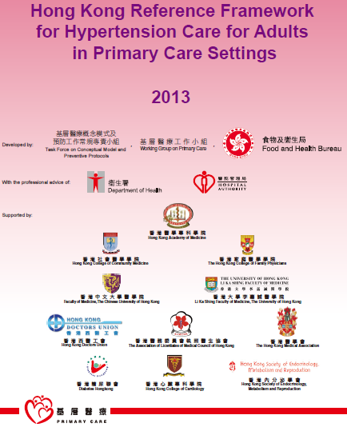
Further Reading
Hong Kong Reference Framework for Hypertension Care for Adults in Primary Care Settings
http://www.pco.gov.hk/english/resource/professionals_hypertension_pdf.html

Slide 31
Prescribing Exercise to Patients with Heart Disease

Slide 32
Exercise-related Sudden Death in Patient with Cardiac Diseases
CHD accounts for most exercise-related sudden deaths among those aged 35 years or above
A considerable number of fatal MIs were not due to significant stenosis of the coronary arteries but rupture of unstable coronary atherosclerotic plaque possibly during exercise

Slide 33
Long Term Effects of Exercise- IHD
Exercise can improve health outcomes in patients with stable IHD:
Slower disease progression
Significantly fewer ischaemic events
Reduce concomitant atherosclerotic risk factors such as hypertension, hyperlipidaemia, hyperglycaemia, obesity and tobacco use
Exercise-only cardiac rehabilitation reduce total cardiac mortality and all-cause mortality by 31% and 27% respectively

Slide 34
Long Term Effects of Exercise- CHF
Improved physical capacity (an increase of 10 to 30% of the maximum physical capacity)
Improved quality of life
Improved endothelial function
Reduced serum catecholamine levels
Reduced morbidity and hospital re-admission rates
Possible reduction of all-cause mortality
Possible improvement of resting cardiac function

Slide 35
Pre-participation Evaluation
All patients with heart disease should have their clinical status carefully reviewed by relevant specialists before heading for an exercise programme
A physical exercise testing is often necessary to identify any potentially dangerous electrocardiographic abnormalities and to stratify risks in patients with heart disease

Slide 36
Pre-participation Evaluation
Possible Investigations:
Resting ECG, Holter ECG monitoring, Echo, Physical exercise test (using treadmill or bicycle), Physical or pharmacological stress test with single PECT, Maximal physical or pharmacological stress with Echo or MRI, or Coronary angiography
Aims to find out:
Ischaemia, arrhythmias, structural abnormalities e.g. cardiac hypertrophy, regional wall motion abnormalities, ventricular dysfunction, perfusion defects, coronary flow disturbances or abnormal coronary anatomy

Slide 37
Recommendations for Exercise Prescription
Exercise prescribed according to FITT principle
FITT of the Exercise prescribed should be tailored to each individual in accordance with
Underlying pathology of the heart disease
their physical condition
aerobic/anaerobic fitness AND
local muscular condition
PA should be linked to other lifestyle modifications to minimise cardiac risk

Slide 38
Good Practices for Cardiac Patients Undertaking Physical Activity
No exercise should be started in unstable cardiac patients e.g. cardiac tamponade, acute pulmonary edema, etc
No exercise in case of unusual asthenia, fever or viral syndrome
Adapt the intensity of PA to the environmental conditions, temperature, humidity and altitude
Include three periods in each physical activity session: warm-up, training and cool-down
Proper warm-up and cool-down phases may have an anti-anginal and possibly cardioprotective effect
Advise low-impact aerobic activity to minimise risk of musculoskeletal injury

Slide 39
Good Practices for Cardiac Patients Undertaking Physical Activity
The level of supervision and monitoring during exercise depends on the result of risk stratification from patient assessments and clinical evaluations
Recommend gradual increases in dosage of PA over time
Terminate exercise immediately if warning signs or symptoms occur
Avoid smoking at all times
Hot shower, which may result in an increased heart rate and arrhythmias, should be avoided during the 15 mins after PA

Slide 40
Special Precautions
Patients with Ischemic Heart Disease
PA contraindicated for patients with unstable angina
Avoid competitive sports
Patients with Congestive Heart Failure
PA contraindicated in case of new onset AF and obstructive valvular heart disease
Aquatic exercise is generally safe to CHF patients and could be used to improve exercise capacity
But it may not be suitable for all CHF patients because head-up immersion and the hydrostatically-induced volume shift MAY result in ↑LV volume loading, with ↑of heart volume and pulmonary capillary wedge pressure

Slide 41
Special Precautions
Patients with pacemakers
Can participate only in exercise consistent with the limitation of the underlying heart disease
Avoid Ex with risk of bodily impact/pronounced arm movements
Valvular heart disease patients
Physical check-ups and exercise testing should be conducted

Slide 42
As a Responsible GP
Should advocate exercise by prescribing exercise after investigation and thorough assessment OR
Referring the patients to specialist consultation or cardiac rehabilitation program
Teach patients with heart disease to monitor their S/S for medical emergency
Know the contraindications to exercise training e.g. unstable angina , decompensated HF

Slide 43
Prescribing Exercise to Overweight and Obese Patients

Slide 44
Obese People’s Acute Response to Exercise
little impact on being overweight/obese
Exercise can have deleterious effects on the obese person who overdoes a single exercise routine
Excessive load on weight-bearing joints and spine
Impaired thermoregulation in hot environmental conditions
Mental distress and physical discomfort

Slide 45
Long Term Effects of Exercise
PA (45mins×3 times/wk) + diet (600 kcal/deficit or low fat) results in an approximate weight ∆ of  1.95 kg (range = 1.0-3.6kg) compared to diet alone at 12 months
Yet PA appeared to be less effective than diet as a sole weight loss intervention

Slide 46
Weight Management
Weight Management should be emphasized as a long term goal
need to produce a negative energy balance by decreasing energy intake from diet and increasing energy expenditure from exercise
target of weight reduction should be limited to ≤ 1 kg / wk (i.e. energy deficit of 7700kcal/wk)
Dieting alone may lower metabolic rate which in long run may increase body weight

Slide 47
Recommendations for Prescribing Aerobic Exercise to Overweight and Obese Patients
Frequency: ≥ 5 days/wk
Intensity: Moderate- to vigorous-intensity
Time:
45-60 min/day of moderate-intensity aerobic activity
To avoid regaining of weight: 60-90 min/day of activity
Type:
Exercise requires little skill to perform is preferable
Aquatic and walking exercises are excellent choices
Progression: starts with long duration (with intermittent resting) and lower intensity exercise

Slide 48
Special Considerations on Ex Prescription
Presence of other comorbidities (e.g. dyslipidaemia, HT, DM, etc.) may increase risk stratification
Aerobic exercise as major supplemented with resistance exercise (as minor)
Prescription of higher PA targets (i.e. ≥ 300 mins per week of moderate-intensity PA) only resulted in significantly greater weight loss when :
inclusion of family members in programme
small group meetings with exercise coaches OR
small monetary incentives

Slide 49
Special Considerations on Ex Prescription
Vigorous exercise is probably not appropriate for the very obese (BMI > approximately 35 kg/m²)
Presence of musculoskeletal conditions and limitations of exercise capacity may require modifications to exercise
Weight-bearing PA may be difficult for some individuals with BMI > approximately 35 kg/m², particularly for those with joint problems
gradually increasing non-weightbearing PA (e.g. cycling, swimming, water aerobics, etc.) should be encouraged

Slide 50
Special Considerations
Modify lifestyles with the use of behavioral modifications skills
Lifestyle PA is recommended, e.g. E.g. playing with children, mopping the floor, climbing up stairs at train stations, etc.

Slide 51
Prescribing Exercise to Patients with Osteoarthritis

Slide 52
Acute Response to Exercise
Some may experience an exacerbation of symptoms
The vast majority (including those severely affected) will neither develop adverse reaction to controlled exercise nor experience an increase in the severity of arthritis

Slide 53
Long Term Benefits of Exercise
Regular exercise is essential part of the management of OA knee
Aerobic Exercise is associated with:
Reduced pain & medication intake
Improved muscle strength
Improved physical functioning & reduced disability
Improved stair climbing and walking distance
Improved balance
Improved self-efficacy and mental health

Slide 54
General Recommendations for Prescribing Exercise to Patients with Osteoarthritis
Could follow the recommendations for exercise participation for apparently healthy adults
Adequate warm-up & cool-down periods for minimizing pain
Progression in duration of activity should be emphasised over increased intensity
Stretching exercise should be emphasised and performed at least daily

Slide 55
Recommendations for Prescribing Aerobic Exercise to Patients with Osteoarthritis
Frequency: Perform aerobic PA 3-5 days/wk
Intensity:
A combination of moderate and vigorous-intensity aerobic exercise is recommended
Initial exercise should begin at lower levels of moderate intensity (e.g. about 40% HRR) for those who have been sedentary or limited by pain

Slide 56
Recommendations for Prescribing Aerobic Exercise to Patients with Osteoarthritis
Time:
Start engaging in short bouts of 5-10 min to accumulate 20-30 min/day, with a goal of progressing to a total of 150 min/wk of moderate-intensity activity
Type:
Activities having low joint stress are recommended e.g. walking, cycling or swimming

Slide 57
Recommendations for Prescribing Resistance Exercise to Patients with Osteoarthritis
Frequency: Perform ≥ 2 nonconsecutive days/wk
Intensity:
Start with a relatively low amount of load (e.g. 10% 1-RM) for those with severe arthritis
Progress at a maximal rate of 10% increase per week as tolerated to the point of pain tolerance and/or low to moderate intensity (i.e. 40–60% 1-RM)
Time:
Each target muscle group should be trained for a total of a total of >1 set with 10 to 15 reps/set

Slide 58
Recommendations for Prescribing Resistance Exercise to Patients with Osteoarthritis
Type:
8-10 exercises (follow the recommendations for healthy adults)
Individuals with significant joint pain or muscle weakness could begin with maximum voluntary isometric contractions around the affected joint
Training all major muscle groups as recommended is the ultimate goal
Incorporate functional exercises such as sit-to-stand and step-ups to improve neuromuscular control and maintenance of activity of daily living
Tai chi may reduce pain and improve physical function, self-efficacy, depression, and health-related quality of life for people with knee OA

Slide 59
Special Precautions for Patients with Osteoarthritis
Avoid strenuous exercises during acute flare-ups
Use of painkillers during the 1st weeks of an exercise programme might not only facilitate joint movement but also drastically improve patient compliance
Exercise during the time of day when pain is typically least severe and/or in conjunction with peak activity of pain medications
Some discomfort during/immediately after exercise may be expected. If joint pain persists for 2 hours after Ex and exceeds the level of pain before exercise, the exercise dosage should be adjusted

Slide 60
Special Precautions for Patients with Osteoarthritis
In case of severe joint pain/obesity, an initial period of water-based exercise may be helpful
Appropriate shoes that provide shock absorption and stability
Healthy weight loss and maintenance should be encouraged to avoid obesity

Slide 61
Prescribing Exercise to Patients with Osteoporosis

Slide 62
Patients’ Acute Response to Exercise
Bone is a dynamic tissue capable of continually adapt to changing mechanical environment
When a bone is loaded in compression, tension or torsion, bone tissue is strained and lead to osteoclast and osteoblast recruitment to model bone to better suit its new mechanical environment
Mechanotransduction: this process of turning a mechanical signal into a biochemical one
Possibility of inducing pain and fracture

Slide 63
Long Term Benefits of Exercise
Weight-bearing aerobic exercises and muscle-strengthening exercises have been shown to be an integral part of osteoporosis treatment
A regular and properly designed exercise programme may help to prevent falls and fall-related osteoporotic fractures, which in turn reduces the risk of disability and premature death

Slide 64
Recommendations for Prescribing Exercise to Patients with Osteoporosis
All three components of an exercise program are needed for strong bone health:
Weight-bearing aerobic exercise such as jogging, brisk walking, stair climbing;
Muscle strengthening exercise with weights; and
Balance training such as Tai Chi.
In general, prescribe moderate intensity exercise that does not cause or exacerbate pain
Initial training sessions should be supervised and monitored by personnel who are sensitive to special needs of older adults

Slide 65
Recommendations for Prescribing Aerobic Exercise to Patients with Osteoporosis
Frequency: Perform aerobic PA on ≥ 3 days/wk
Intensity: To perform moderate intensity for weight-bearing aerobic exercise
Time: Perform 20-30min per session to a total of ≥ 150 min/wk
Type: Weight-bearing aerobic exercise includes stair-climbing/ descending, walking with intermittent jogging and table-tennis

Slide 66
Recommendations for Prescribing Resistance Exercise to Patients with Osteoporosis
Frequency: Perform ≥ 2 nonconsecutive days/wk, ideally 3 times/week
Intensity:
To perform moderate intensity in terms of bone loading forces, but some may be able to tolerate more intense training
For individuals at risk of osteoporosis, go for high-intensity (80-90% 1-RM) if tolerable
Time: Each target muscle group should be trained for a total of ≥1 sets with 8-10 reps/set

Slide 67
Recommendations for Prescribing Resistance Exercise to Patients with Osteoporosis
Type:
8-10 resistance exercises
Any form of training that are site specific i.e. targeting areas such as the muscle groups around the hip, the quadriceps, dorsi/plantar flexors, rhomboids, wrist extensors and back extensors

Slide 68
Special Precautions
Majority are old and sedentary and thus considered as moderate to high risk for atherosclerotic disease
Exercises that involve explosive movements or high-impact loading should be avoided.
Low impact weight-bearing activity is characterised by always having one foot on the floor
Ballistic movements or jumping (both feet off floor) is termed high impact training

Slide 69
Special Precautions
Exercises that cause twisting (e.g. golf swing), bending or compression of the spine (e.g. rowing or sit-ups) should be avoided
Exercise which highly demand on balance and agility (e.g. Rope Jumping, Skiing, etc) should be avoided to prevent risk of fall
Exercise with long lever arm that induce high torque on the joint should be avoided (e.g. High resistance straight leg raising exercise may increase the risk of osteoporotic fracture of the NOF)

Slide 70
Improving Exercise Adoption and Maintenance

Slide 71
Improving Exercise Adoption and Maintenance
Effective physical activity interventions include
increasing social support and self-efficacy
reducing barriers to exercise
using information prompts
making social and physical environmental changes
Recommended skills and techniques:
Application of the Stages of Change Model
Patient-centred counselling
The Five A’s Model

Slide 72
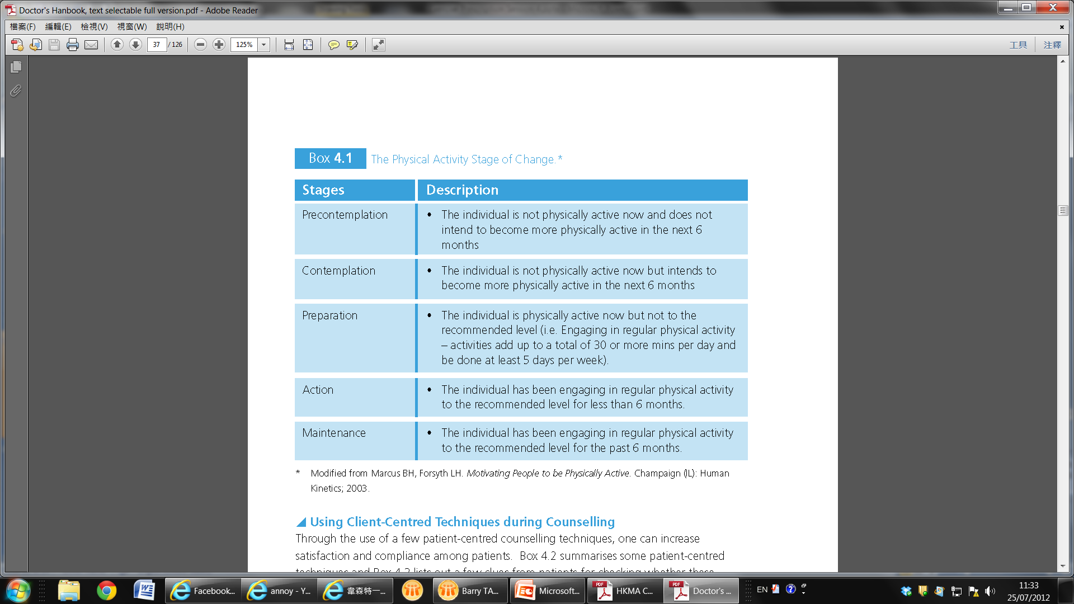
The Stages of Change Model

Slide 73
Applying the Stages of Change Model
Knowing a person’s stage of change suggests different strategies for working with that particular person
For earlier stages of change: more effective to use the cognitive processes of change, such as increasing knowledge and comprehending the benefits
For later stages: more effective to use behavioural processes of change, such as enlisting social support and substituting alternatives

Slide 74
Patient-centred Counselling
Ask simple, open-ended questions
Listen and encourage with verbal and non-verbal prompts
Clarify and summarise
Check your understanding of what the patient said and check to see that the patient understand what you said
Use reflective listening

Slide 75
How You Know When You are Using Patient-Centred Approach
You are speaking slowly
The patient is talking about behavioural change
The patient appears to be making realisations and connections that he or she has not previously considered
The patient is talking more than you are
You are listening intently and directing the conversation when appropriate
The patient is asking you for information or advice

Slide 76
The Five-A's Model to Facilitate Behavioural Changes
Assess
Advice
Agree
Assist
Arrange

Slide 77
The Five-A's Model to Facilitate Behavioural Changes
Assess
Current PA (type, frequency, intensity, and duration)
Contraindications to PA
Patient's readiness for change
Patient-oriented benefits
Social support
Self-efficacy (Patient's self-confidence for change)

Slide 78
The Five-A's Model to Facilitate Behavioural Changes
Advise
Provide individually-tailored message:
Precontemplation:“As your physician, it's my responsibility to recommend that you get at least 30 min of moderate-intensity PA, such as walking fast on at least 5 days of the week”
Contemplation: Emphasise benefits that the patient cares about
Preparation: Suggest that the patient help someone he or she cares about get physically active for health
Action/maintenance:“Congratulations, you are doing one of the most important things you can for your health”
Personalise risk
Personalise immediate and long term benefits of change

Slide 79
The Five-A's Model to Facilitate Behavioural Changes
Agree
Agree on the next step and initiate shared decision making based on the patient's stage of change
Precontemplation: ask the patient if you can talk about physical activity in the future
Contemplation: discuss the next steps
Preparation : help the patient make a plan and set a start date
Action/maintenance : Ask if the patient is ready to start another healthy behaviour

Slide 80
The Five-A's Model to Facilitate Behavioural Changes
Assist
Provide the patient with a written prescription
Correct misunderstanding
Provide information and resources: printed support materials; self-monitoring tools (e.g., pedometer); or internet-based resources
Provide social support
Identify barriers to change and offer problem solving
Teach skills/recommend coping strategies
Describe options available and identify community resources (e.g. leisure and sports facilities provided by LCSD)
Refer when appropriate

Slide 81
The Five-A's Model to Facilitate Behavioural Changes
Arrange
Schedule a FU visit
Provide telephone or e-mail reminders (e.g., have a staff member call or e-mail the patient on the start date of the behaviour change) and internet-based counselling
Refer the patient for additional assistance if indicated (e.g., dietitian or qualified physical trainer)

Slide 82
Some More Practical Recommendations to Enhance Exercise Adherence
Clarify individual needs to establish the motive for exercise
Identify safe, convenient and well-maintained facilities for exercise
Identify individualised attainable goals and objectives for exercise
Identify social support for exercise
Identify environmental supports and reminders for exercise
Identify motivational exercise outcomes for self-monitoring of exercise progress and achievements, such as step counters

Slide 83
Some More Practical Recommendations to Enhance Exercise Adherence
Emphasise and monitor the acute or immediate effects of exercise
Emphasise variety and enjoyment in the exercise programme
Establish a regular schedule of exercise
Provide qualified, personable and enthusiastic exercise professionals
Minimise muscle soreness and injury by participation in exercise of moderate intensity, particularly in the early phase of exercise adoption

Slide 84
Prevention of Exercise Related Injuries

Slide 85
Prevention of Exercise Related Injuries
Light meal and well hydrated before exercise
Proper sports apparatus
Listen to your body, don’t work through pain / discomfort
Time for rest and recovery
Consult a health care / exercise professionals when in doubt

Slide 86
Prevention of Exercise Related Injuries
Adequate Warm up and cool down (low intensity workout)
Stretch before and after workout (control, slow and gentle)
Progress gradually (Time/Freq --> Intensity)
Cross-training to reduce overuse
Avoid high risk movement: Standing toe-touches, full squat, sit-up, double leg raises, behind neck press, etc.
Treat musculoskeletal injuries with PRICE (Protection, Rest, Ice, Compression, Elevation)

Slide 87
Exercise Demonstration Clinical Case Studies

Slide 88
Exercise Practice
Warm Up Exercise – Ballistic Stretching
Aerobic Exercise (modification for special population)
Resistance Exercise / Circuit training (modification for special population)
Balance Exercise
Cool Down Exercise – Static Stretching

Slide 89
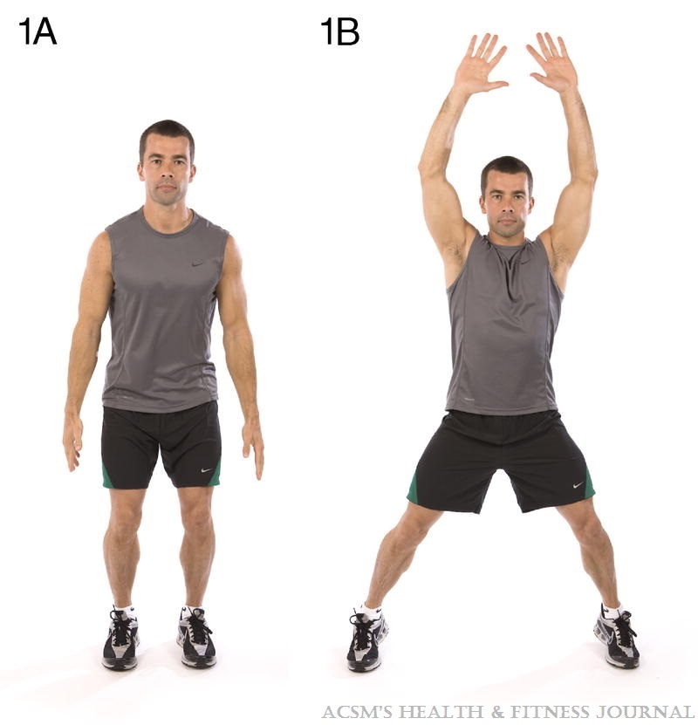
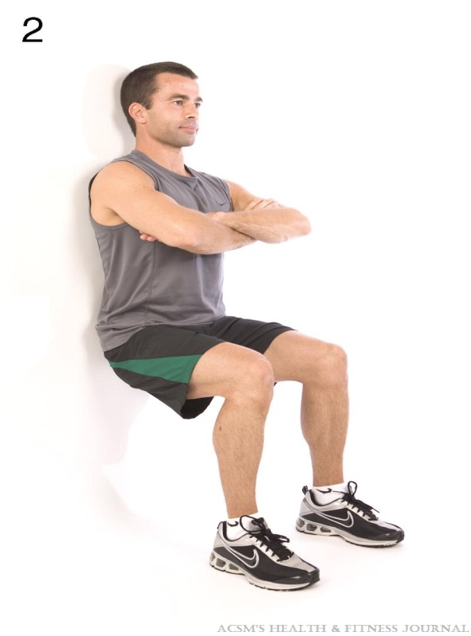
Examples of Circuit Training & Resistance Exercise using body weight
Source: Klika B. and Jordon C (2013). High Intensity Circuit Training Using Body Weight: Maximum Results with Minimal Investment. ACSM's Health and Fitness Journal 17(3)8-13.
>=90º
OA Knee
Repetitions: 15 reps over 60s; Sets: 2-3 (with >30s intermittent rest)

Slide 90
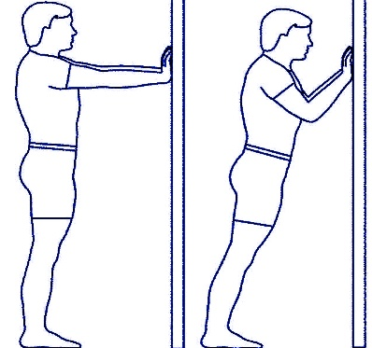
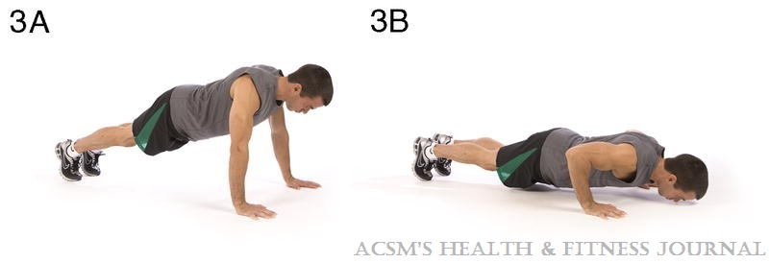
Examples of Circuit Training & Resistance Exercise using body weight
Wall Push-up
Source: Klika B. and Jordon C (2013). High Intensity Circuit Training Using Body Weight: Maximum Results with Minimal Investment. ACSM's Health and Fitness Journal 17(3)8-13.
Repetitions: 15 reps over 60s; Sets: 2-3 (with >30s intermittent rest)

Slide 91
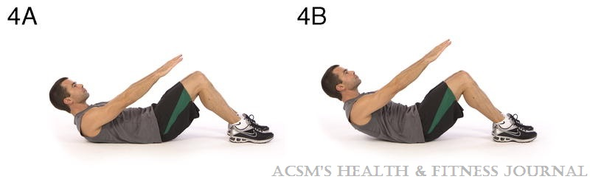
Examples of Circuit Training & Resistance Exercise using body weight
Pillow Support
Pillow Support
Source: Klika B. and Jordon C (2013). High Intensity Circuit Training Using Body Weight: Maximum Results with Minimal Investment. ACSM's Health and Fitness Journal 17(3)8-13.
Repetitions: 15 reps over 60s; Sets: 2-3 (with >30s intermittent rest)

Slide 92
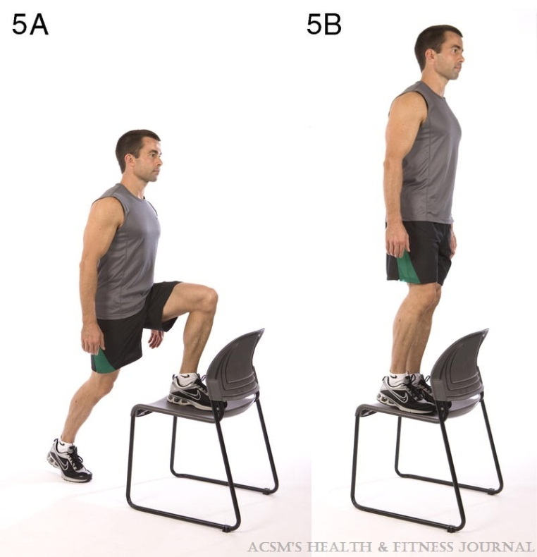
Examples of Circuit Training & Resistance Exercise using body weight
Lower seat height (around 6-12 inch)
- Hip Flex >90º
- Knee Flex <90º
Source: Klika B. and Jordon C (2013). High Intensity Circuit Training Using Body Weight: Maximum Results with Minimal Investment. ACSM's Health and Fitness Journal 17(3)8-13.
OA Knee
Repetitions: 15 reps over 60s; Sets: 2-3 (with >30s intermittent rest)

Slide 93
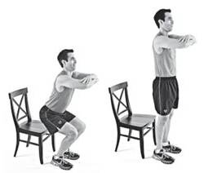
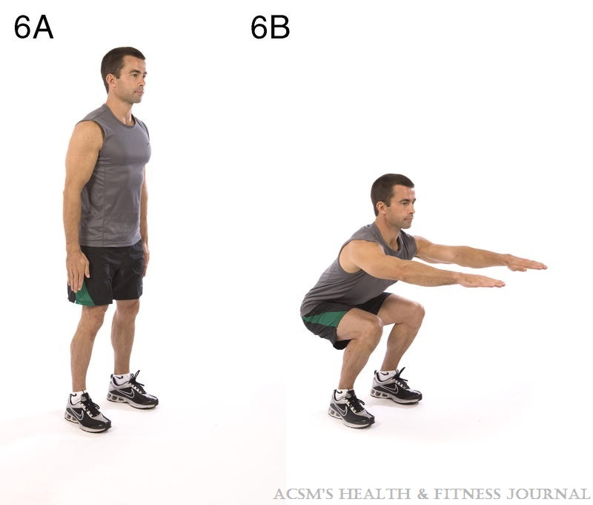
Examples of Circuit Training & Resistance Exercise using body weight
Sit to Stand Ex.
Back Straight,
Sit backwards,
Keep Knee Cap behind toes
Source: Klika B. and Jordon C (2013). High Intensity Circuit Training Using Body Weight: Maximum Results with Minimal Investment. ACSM's Health and Fitness Journal 17(3)8-13.
>=90º
OA Knee
Repetitions: 15 reps over 60s; Sets: 2-3 (with >30s intermittent rest)

Slide 94
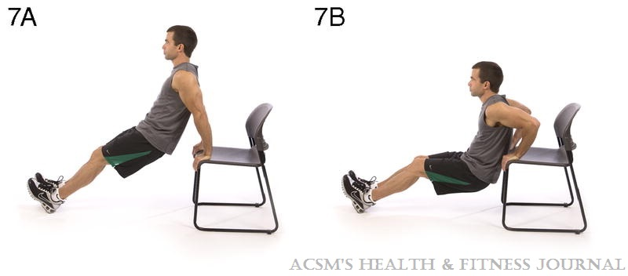
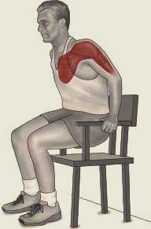
Examples of Circuit Training & Resistance Exercise using body weight
Modified triceps push in sitting
Source: Klika B. and Jordon C (2013). High Intensity Circuit Training Using Body Weight: Maximum Results with Minimal Investment. ACSM's Health and Fitness Journal 17(3)8-13.
Repetitions: 15 reps over 60s; Sets: 2-3 (with >30s intermittent rest)

Slide 95
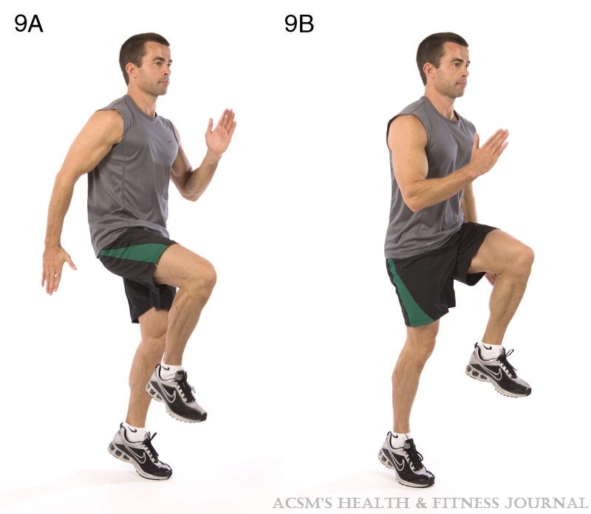
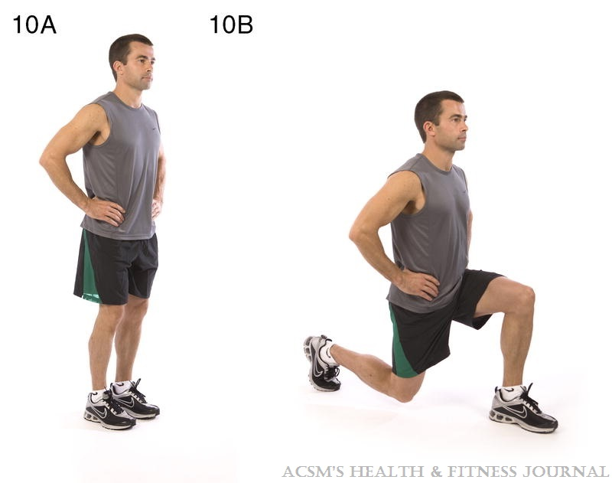
Examples of Circuit Training & Resistance Exercise using body weight
Shoulder width,
larger base of support,
easier to maintain balance
Source: Klika B. and Jordon C (2013). High Intensity Circuit Training Using Body Weight: Maximum Results with Minimal Investment. ACSM's Health and Fitness Journal 17(3)8-13.
>=90º
Repetitions: 15 reps over 60s; Sets: 2-3 (with >30s intermittent rest)

Slide 96
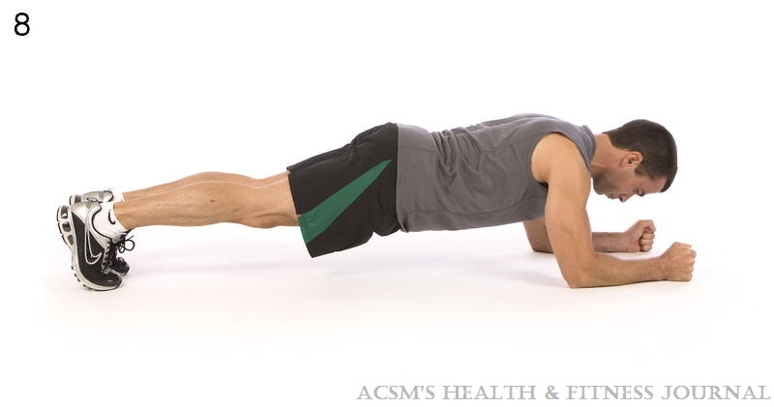
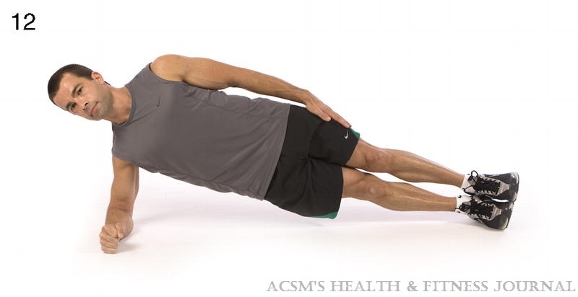
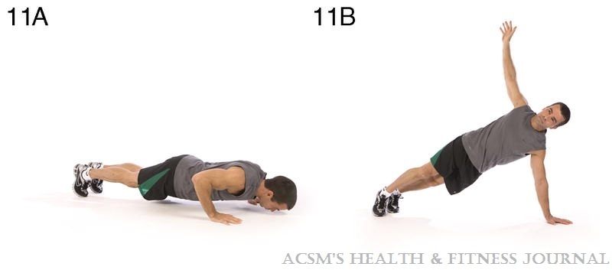
Examples of Circuit Training & Resistance Exercise using body weight
Advance Exercise for Core Muscle Training
Source: Klika B. and Jordon C (2013). High Intensity Circuit Training Using Body Weight: Maximum Results with Minimal Investment. ACSM's Health and Fitness Journal 17(3)8-13.
Repetitions: 15 reps over 60s; Sets: 2-3 (with >30s intermittent rest)
Notes:
Source: Klika B. and Jordon C (2013). High Intensity Circuit Training Using Body Weight: Maximum Results with Minimal Investment. ACSM's Health and Fitness Journal 17(3)8-13.

Slide 97
Case Study (1)
Mrs. Chan, 60 years old, with complaints of low back pain and knee pain. She also has diagnosis of diabetes, hypertension. She currently on oral analgesic, hypoglycemic agent and anti-hypertensive medication. She experienced menopause in her early 50s. She is 1.6m high and weighs 80kg. She smokes cigarettes and rarely exercise.
Her older sister has recently suffered a hip fracture. Mrs. Chan starts to worry herself about the risk to sustain a fracture, so she comes to visit you for checkup and advice.
Does she has any risk factors for fracture?
What preventive strategies should be recommended to her?
What treatment options can be offered?
How would you prescribe exercise for Ms. Wong? What are the benefits? Any precautions?

Slide 98
Case Study (2)
Mr. Wong (Height: 1.7m, Weight: 100kg), aged 60, with hyperlipidemia, type 2 diabetes, hypertension, depression diagnosed in 2005, complicated with diabetic retinopathy and diabetic neuropathy. His drug regime included Diamicron, Acertil and Zoloft. Mr. Wong seldom exercise and has sedentary lifestyle. Mr. Wong would like to reduce 20 kg in 3 months. He worried very much about her condition and she would like to start exercise training for better health.
What are the benefits of exercise for Mr. Wong?
Please identify the considerations that should be taken when prescribing exercise for this patient ?
What is your comment on his weight reduction target?
What is your exercise prescription for Mr. Wong?
Mr. Wong always complain of dizziness after short period of physical activities, how would you manage his condition?

Slide 99
Questions and Answers

